Slide 1
Connecticut Aquaculture Funding Opportunities & Research Needs 2019 Connecticut Sea Grant January 30, 2019

Slide 2
Welcome!
Purpose:
Identify upcoming aquaculture funding sources
Discuss research needs identified by industry and regulators
Audience Q&A
Outcome:
Facilitate the development of proposals that address industry needs

Slide 3
CT Sea Grant Omnibus Funding
Call for proposals currently open
$150K per project, 4-5 projects funded
50% match required (in-kind ok)
Must address goals/objectives identified in 2018-2021 Connecticut Sea Grant Strategic Plan https://seagrant.uconn.edu/wp-content/uploads/sites/1985/2017/04/CTSG-strategic-plan-2018-2021.pdf
Review recommendations of CT Shellfish Initiative http://aquaculture.uconn.edu
Must include an effective outreach or education plan that complements the research component
Deadlines: preproposals Feb 25, 2019; full Jun 7, 2019

Slide 4
CTSG Strategic Plan
Proposals are solicited to conduct applied research to develop knowledge and tools in the following areas:
Goal 2: Fisheries, aquaculture, and marine resources provide food and jobs, and sustain economic and cultural values.
Objective 2.1) Management and changing environmental conditions related to fisheries, marine aquaculture or marine resources
Objective 2.2) Public health and socio-economics related to fisheries, marine aquaculture or marine resources

Slide 5
National Sea Grant Funding
Call for proposals is expected
~$6M total avail, amount per project has varied
Review NSGO Strategic Plan 2018-2021 goals https://seagrant.noaa.gov/Portals/1/Strategic%20Plans/SeaGrant-StrategicPlan-2018-2021-006072017-DRAFT.pdf
Review NSGO Aquaculture Vision Plan 2016 https://seagrant.noaa.gov/Portals/0/Documents/Handouts/AquacultureVisionNOAA_March2016.pdf
Must address priority areas in RFP
RFP will be shared via listserv

Slide 6
Survey Approach
Audience: aquaculture industry and regulators
Mail and online (Survey Monkey)
Step 1 = rate research categories as:
“top priority”
“important, but not a priority"
“not a priority”
Step 2 = identify specific research needs
Response rate = 36.6% (45 actual/123 potential)

Slide 7
Top priorities
Percent Number
Climate change 57.78% 26
Contaminants 48.89% 22
Management 46.67% 21
Pathogens 44.44% 20
Economics 31.19% 14
Product development 28.89% 13
Training 26.67% 12

Slide 8
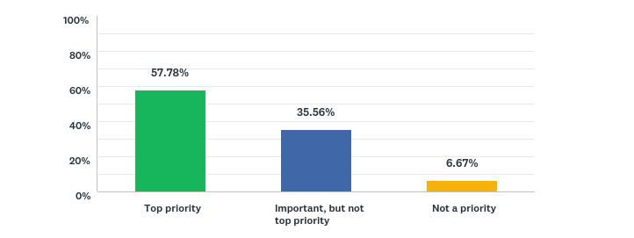
Climate
Suggested research:
Storm surge, flooding, erosion; impacts to seafood operation infrastructure (7)
Ocean acidification; impacts on cultivated shellfish (6)
Rainfall, runoff; harvest area closures; trends and economic impacts (6)
Temperature; impact on species cultivated (5)
Sea level rise; impacts to seafood operation infrastructure (2)
Waste water and storm drain efficiency and design; improvements that would benefit aquaculture (1)

Slide 9
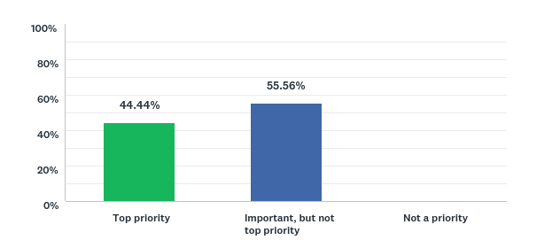
Human, Animal and Plant Pathogens
Suggested research:
Vibrio rapid detection; improve understanding (7)
HAB rapid detection; improve understanding (9)
Antibiotic-free fish production (2)
Emerging pathogens for cultivated seaweed (1)

Slide 10
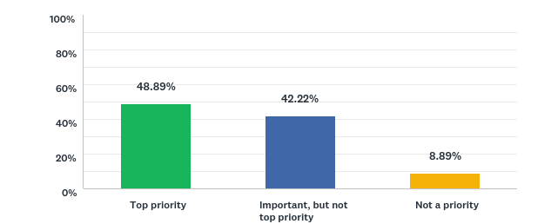
Contaminants
Suggested research:
Plastics in cultured shellfish, improve understanding, purging (12)
Heavy metals in cultured shellfish (7)
PCBs in cultured shellfish (2)
Contaminants in cultured seaweeds (1)
Contaminants in RAS resulting from materials used (1)
Suggested non-research actions:
Public outreach and legislative actions to reduce plastic use (4)

Slide 11
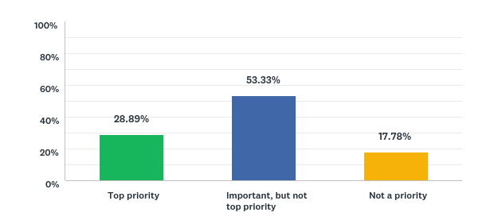
Product research and development
Suggested research:
Species diversification; cultured shellfish and marine/fw finfish (7)
Fish feeds; formulation, cost reduction (5)
Shellfish grow-out systems; comparisons, improved efficacy (3)
Develop new kelp products (1)
Develop probiotics to prevent/reduce contaminants in microalgae cultures (1)
Determine viability of finfish byproducts as feed (1)
Develop dried diatom feed for hatchery reared clams/oysters (1)
RAS systems; improve cost efficiency and reduce carbon footprint (1)
Continue efforts in oyster genetics and breeding (1)

Slide 12
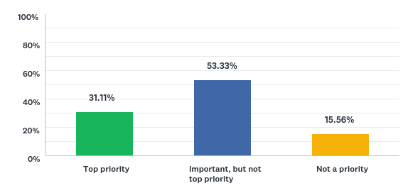
Economics and business
Suggested research:
Develop marketing strategies for local product (8)
Develop marketing strategies for shellfish; value-added products (2)
Conduct value chain analysis for aquaculture sectors (2)
Develop marketing strategies for kelp products (1)

Slide 13
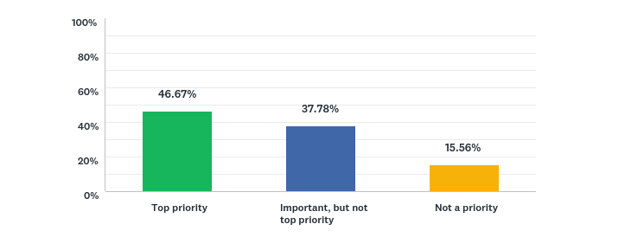
Management
Suggested non-research actions:
Public outreach on aquaculture industry benefits/impacts (7)
Streamline application process for marine aquaculture (5)
Laws encouraging growth of small-scale shellfish operations; leasing (2)
Develop nutrient credit trading program for farmers (1)
Law to increase fines for poaching aquaculture product (1)
Laws encouraging aquaponics (1)
Create notification system via text or email for harvest area closures (1)
Develop municipal shellfish management plans (1)

Slide 14
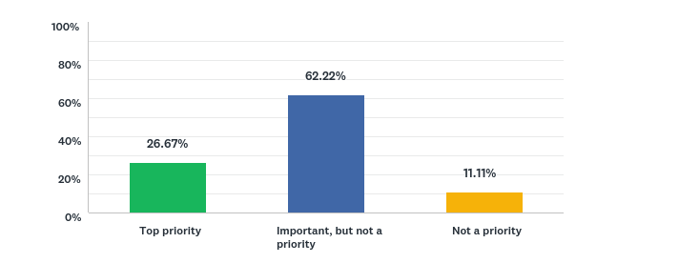
Industry Training and Education
Suggested non-research actions:
Develop hatchery and growout techniques courses; on-water, classroom and online (13)
Develop aquaculture training courses for technical/community colleges (4)
Apprenticeship programs (1)

Slide 15
Other
Suggested research:
Better understand the lack of northern quahog sets in Long Island Sound, causes and influencing factors (1)
Expand research & development of marine ornamental products (1)
Conduct social science to explore how to improve social and political will regarding aquaculture (1)
Better understand the environmental benefits of shellfish culture (1)
Conduct Microbial Source Tracking (MST) of both human and animal source, and include species identification to determine and remedy pathogen inputs adjacent to aquaculture harvest areas (1)

Slide 16
Audience Q & A

Slide 17
Thank you!
Contact:
Dr. Syma A. Ebbin, Research Coordinator Connecticut Sea Grant College Program The University of Connecticut 1080 Shennecossett Road Groton, CT 06340-6048 Tel. (860) 405-9278
E-mail: syma.ebbin@uconn.edu

