Slide 1

BRANFORD COASTAL VULNERABILITY WORKING GROUP

Slide 2
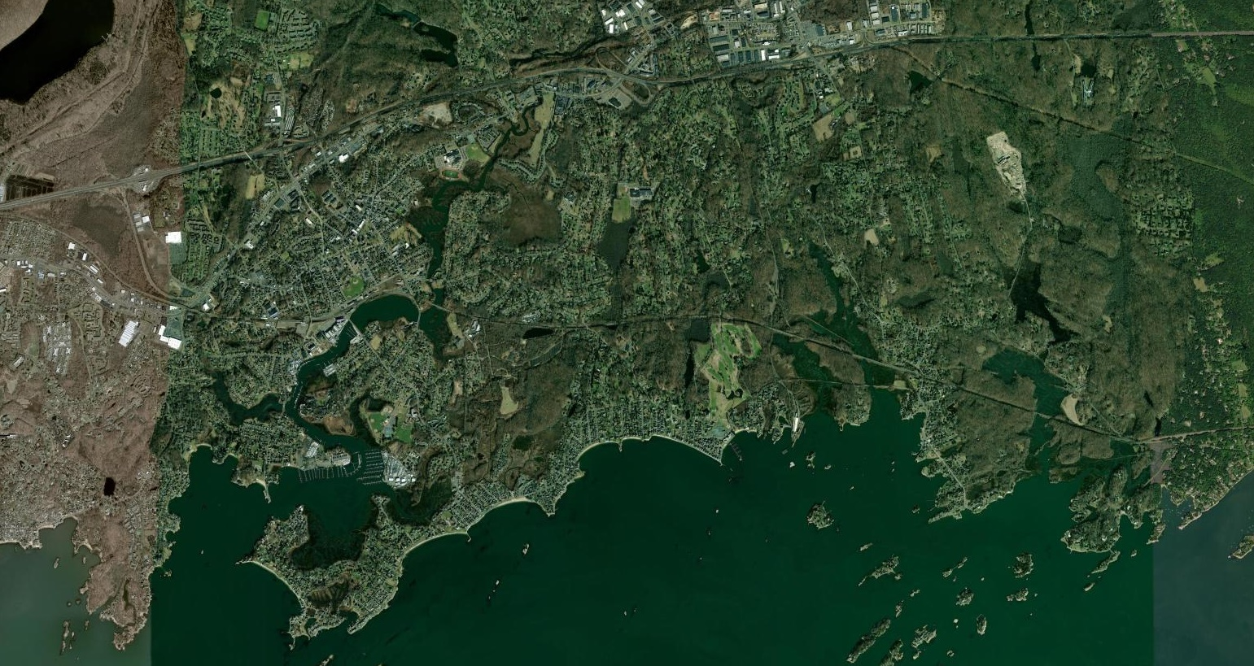
Branford has 20 miles of coastline over 6-mile span

Slide 3
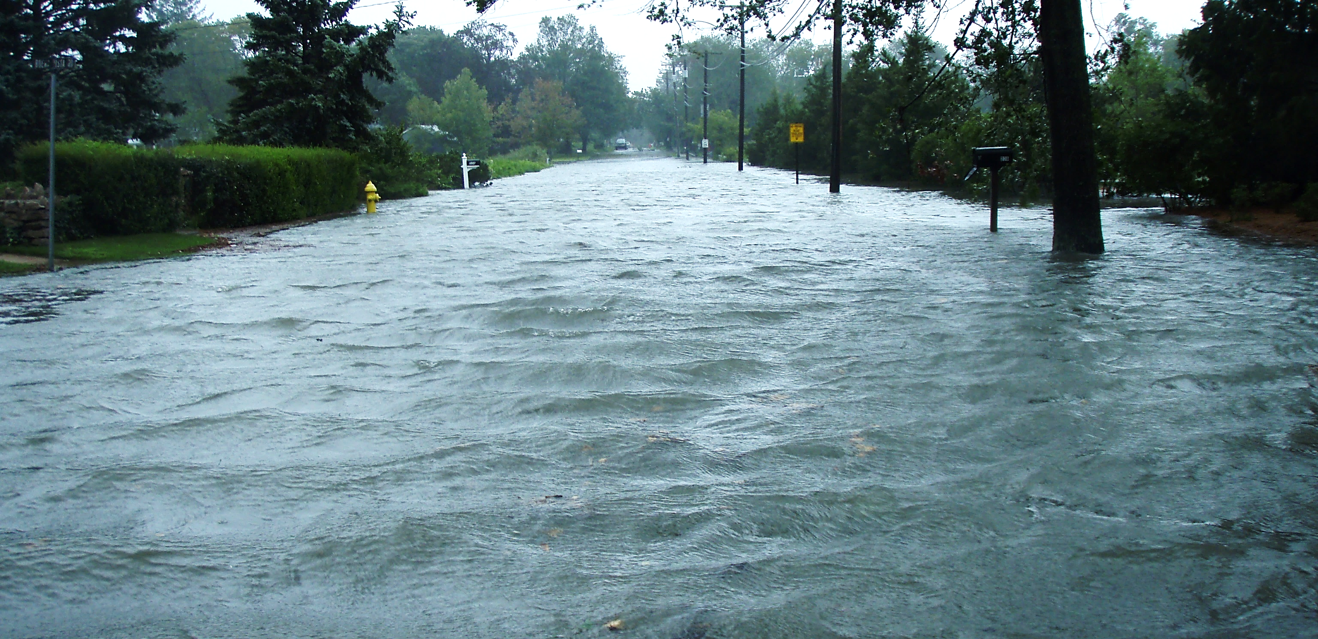
BRANFORD COASTAL VULNERABILITY WORKING GROUP

Slide 4
ROAD FLOODING
Impacts
PUBLIC ACCESS / EMERGENCY SERVICES
BRANFORD COASTAL VULNERABILITY WORKING GROUP

Slide 5
2017 - Branford commissioned a Coastal Resilience Plan
2020 - Branford established a Coastal Vulnerability Working Group
2021 - Branford established a Coastal Resilience Fund increased annually
2022/26 – Focus of CVWG has been on the vulnerability of our infrastructure
Therefore
2024 - Branford engaged MyCoast to help document flood conditions
BRANFORD COASTAL VULNERABILITY WORKING GROUP

Slide 6
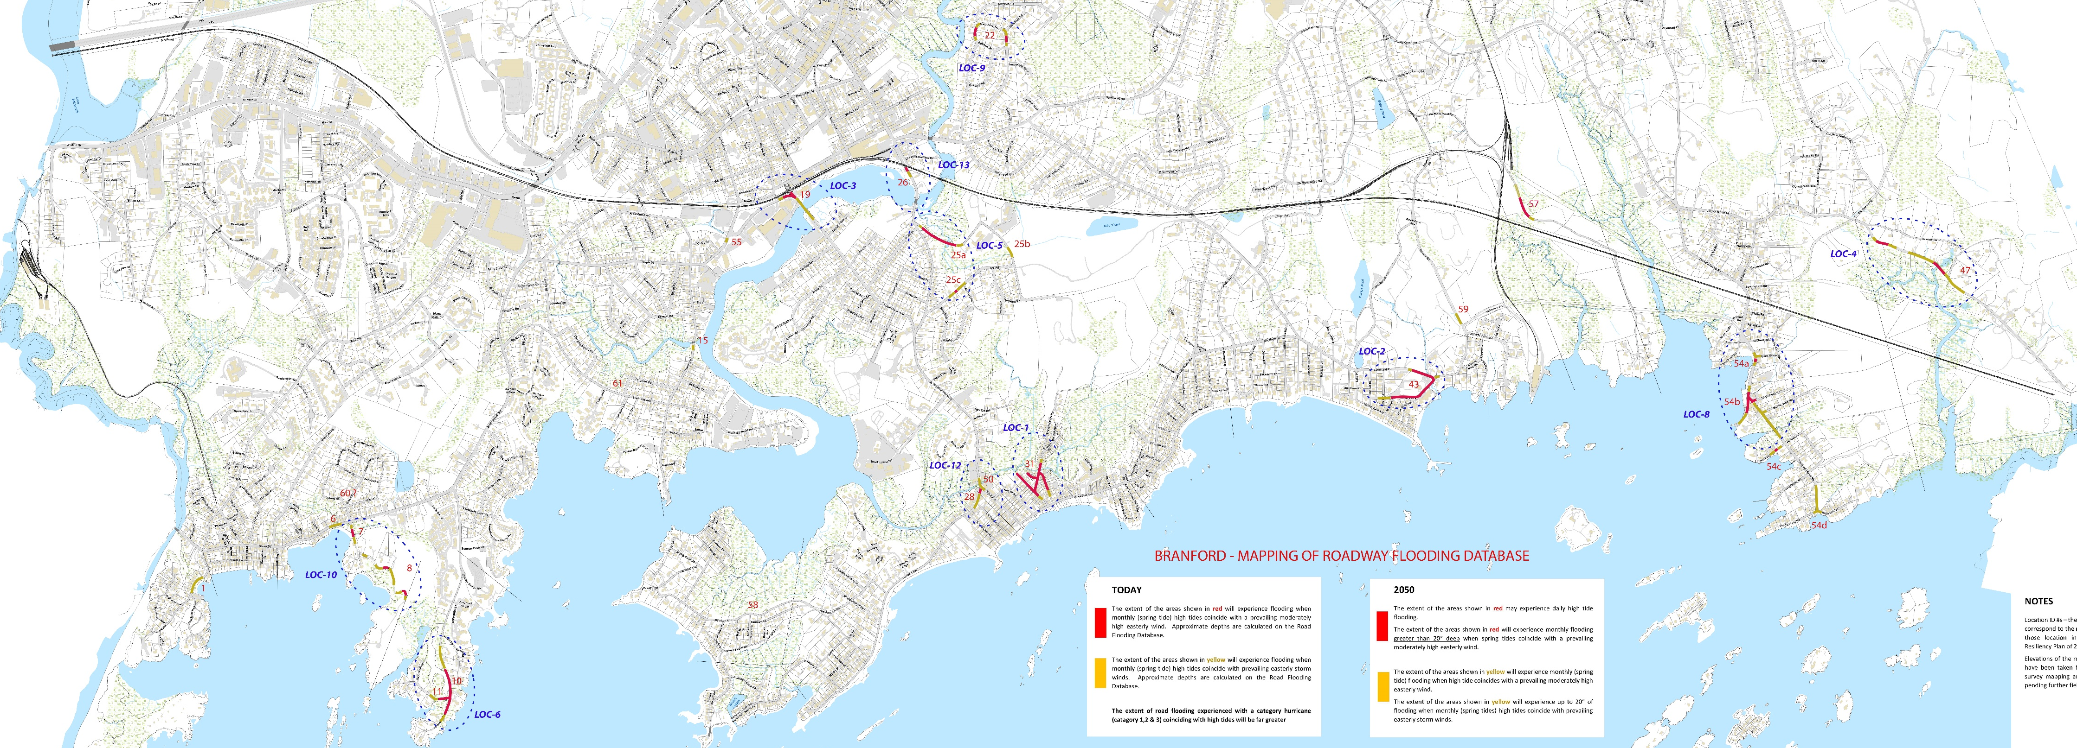
Show map of Branford
BRANFORD COASTAL VULNERABILITY WORKING GROUP

Slide 7
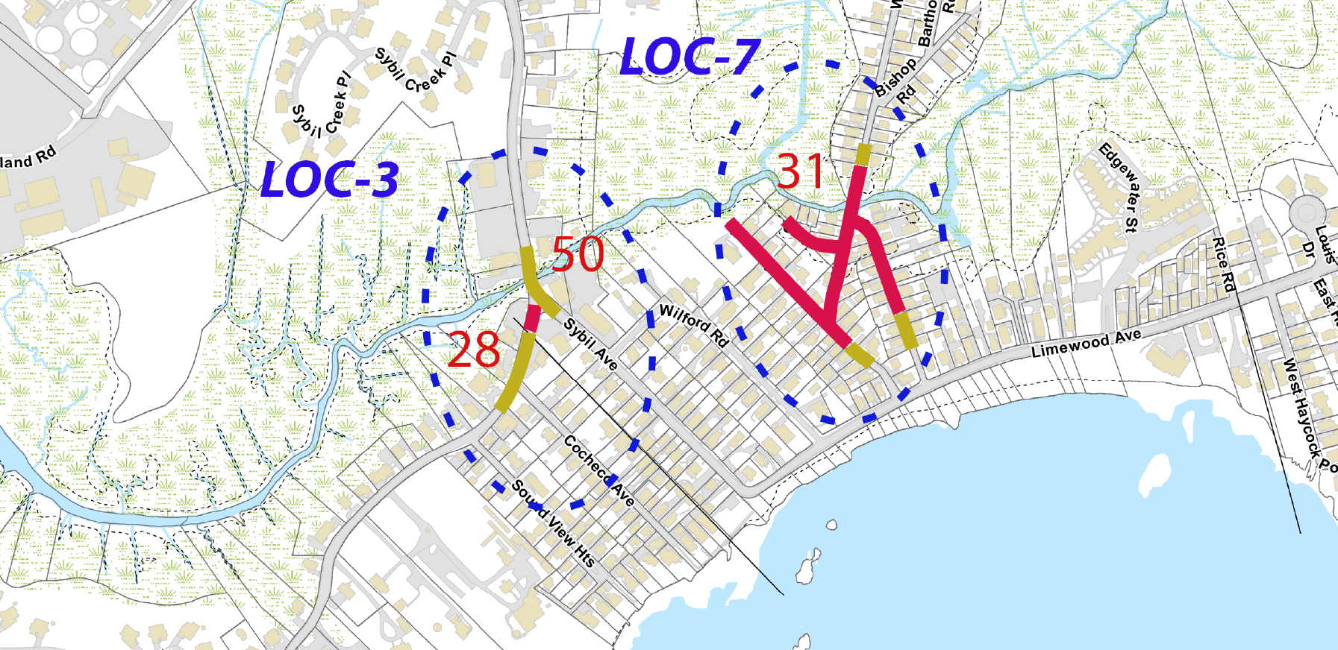
Zoom on a detail of the map showing ID and shading
BRANFORD COASTAL VULNERABILITY WORKING GROUP

Slide 8
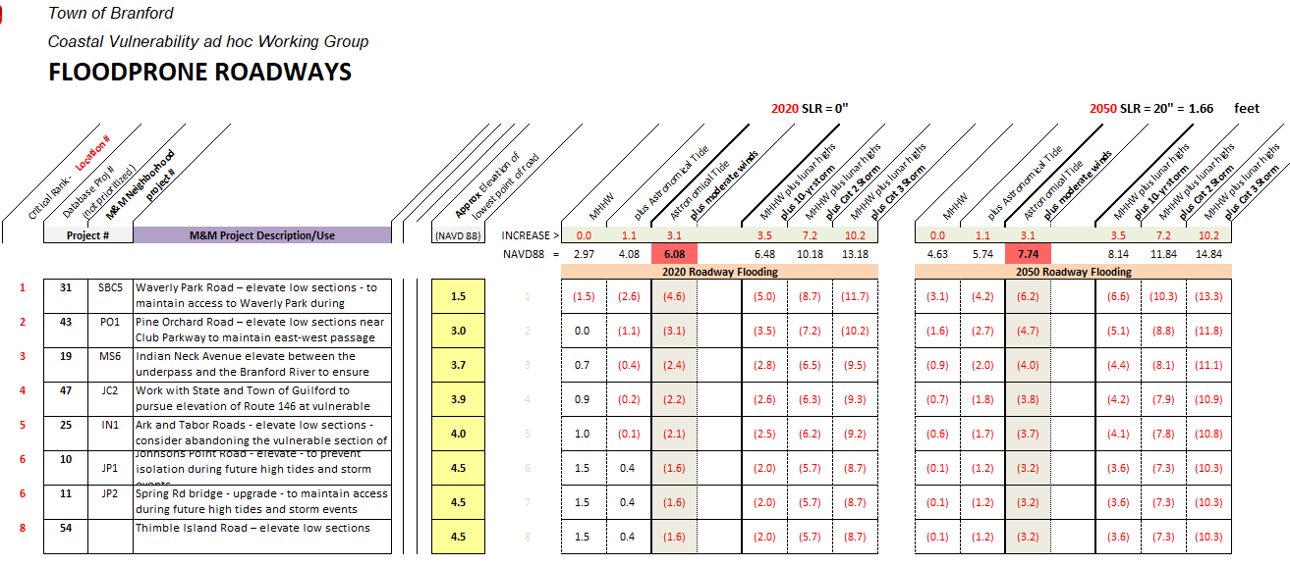
BRANFORD COASTAL VULNERABILITY WORKING GROUP

Slide 10
Objectives
To better understand the dynamics of Branford road flooding through visual images
To accumulate data that would help focus the need and extent of resilience measures
To gather data about how flood levels are impacted by tidal predictions and weather
To use imagery to promote community awareness, involvement, and action
BRANFORD COASTAL VULNERABILITY WORKING GROUP

Slide 11

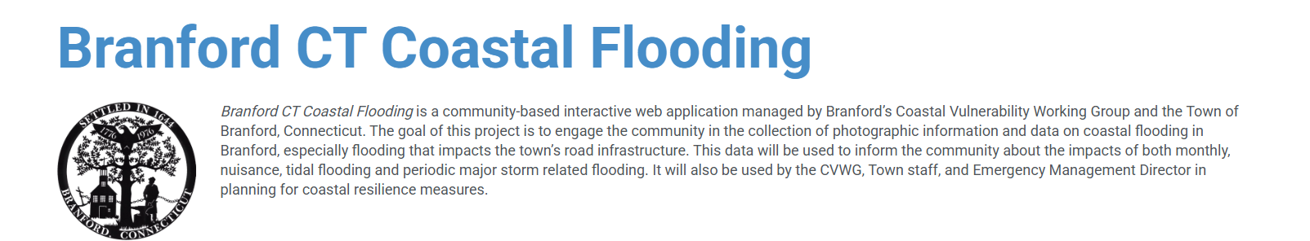
Branford CT Coastal Flooding is a community-based interactive web application managed by Branford’s Coastal Vulnerability Working Group and the Town of Branford, Connecticut. The goal of this project is to engage the community in the collection of photographic information and data on coastal flooding in Branford, especially flooding that impacts the town’s road infrastructure. This data will be used to inform the community about the impacts of both monthly, nuisance, tidal flooding and periodic major storm related flooding. It will also be used by the CVWG, Town staff, and Emergency Management Director in planning for coastal resilience measures
BRANFORD COASTAL VULNERABILITY WORKING GROUP

Slide 12
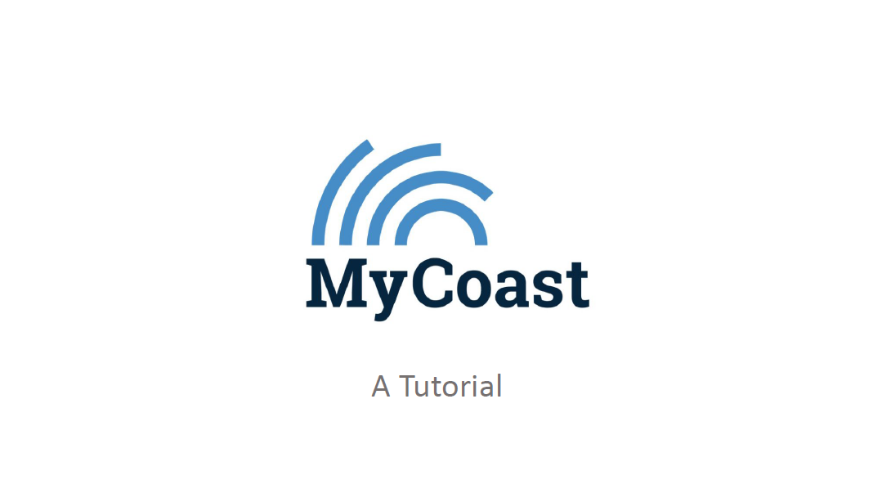
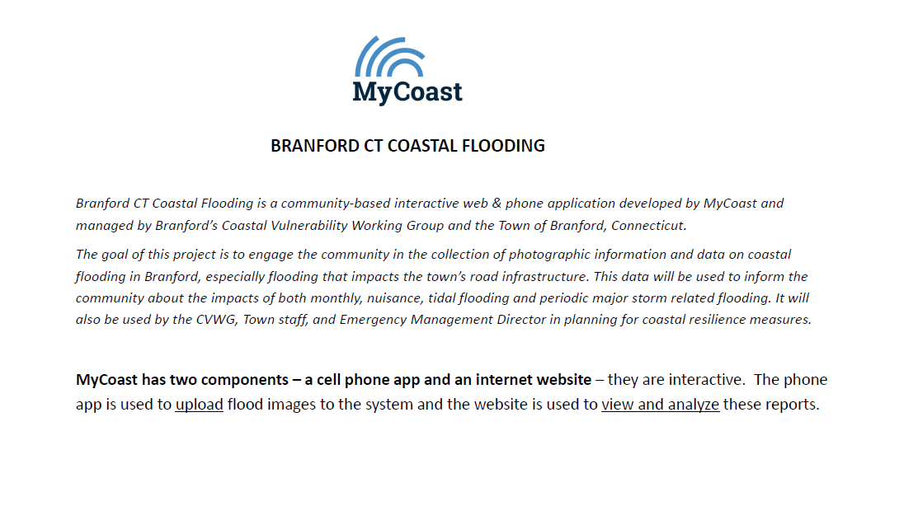
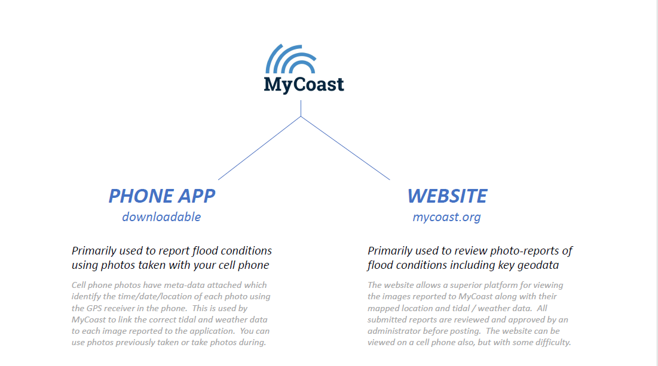
BRANFORD COASTAL VULNERABILITY WORKING GROUP

Slide 13
Challenges
Individual images of flooding without a baseline image for comparison are difficult to evaluate
BRANFORD COASTAL VULNERABILITY WORKING GROUP

Slide 14
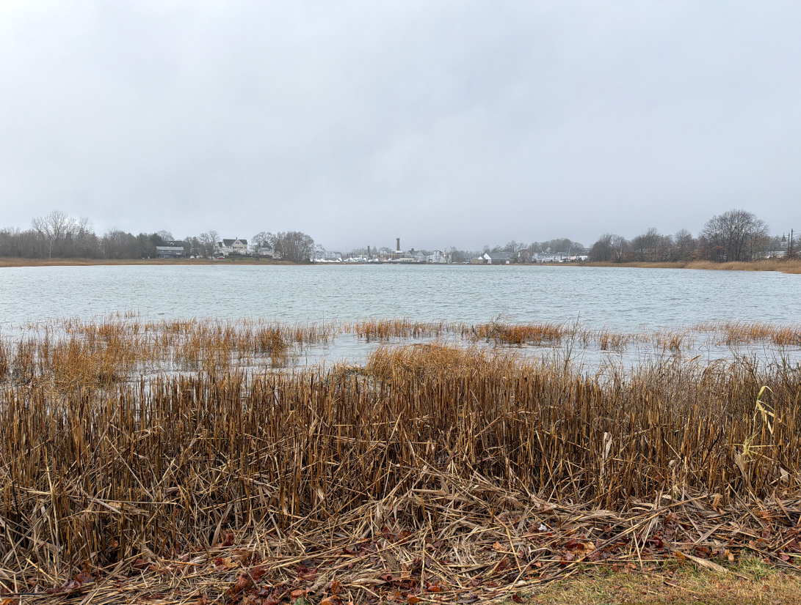
BRANFORD COASTAL VULNERABILITY WORKING GROUP

Slide 15
Challenges
Images of flooding without a baseline image for comparison are difficult to evaluate
Flood reports with tide level elevations alone are difficult to relate to land surveys
Water levels can be established by subtracting (3.42) from the reported Tide levels
An actual local tide level gauge would be better
BRANFORD COASTAL VULNERABILITY WORKING GROUP

Slide 16
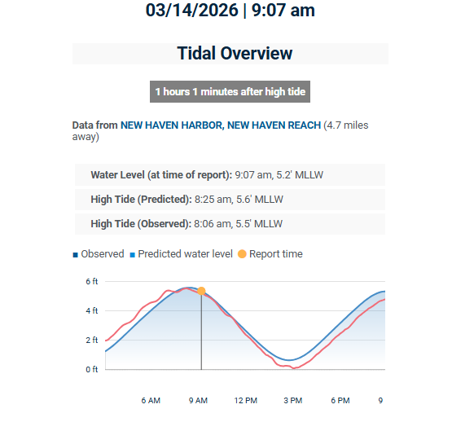
BRANFORD COASTAL VULNERABILITY WORKING GROUP

Slide 17
Challenges
Images of flooding without a baseline image for comparison are difficult to evaluate
Flood reports with tide level elevations alone are difficult to relate to land surveys
NAVD88 levels can be established by subtracting (3.42) from the reported Tide levels
An actual local tide level gauge would be better
BRANFORD COASTAL VULNERABILITY WORKING GROUP

Slide 18
NAVD88 TIDE-LEVEL GAUGE
BRANFORD COASTAL VULNERABILITY WORKING GROUP

Slide 19
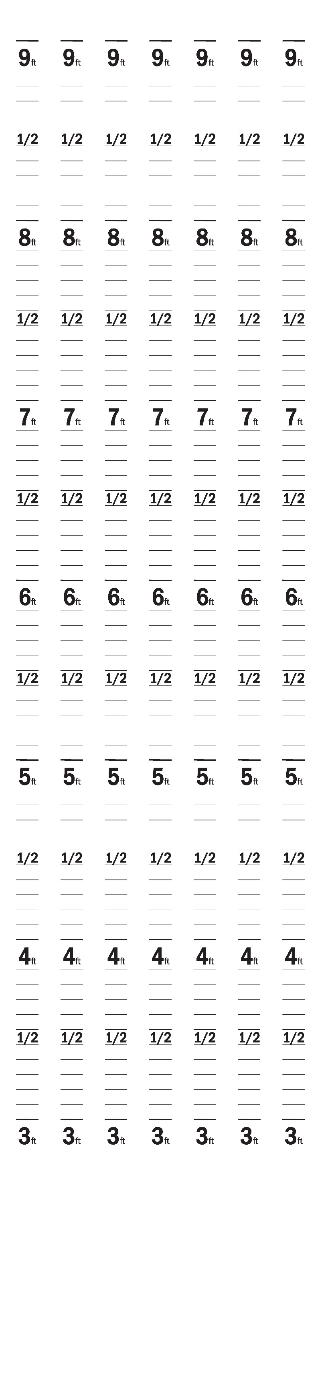
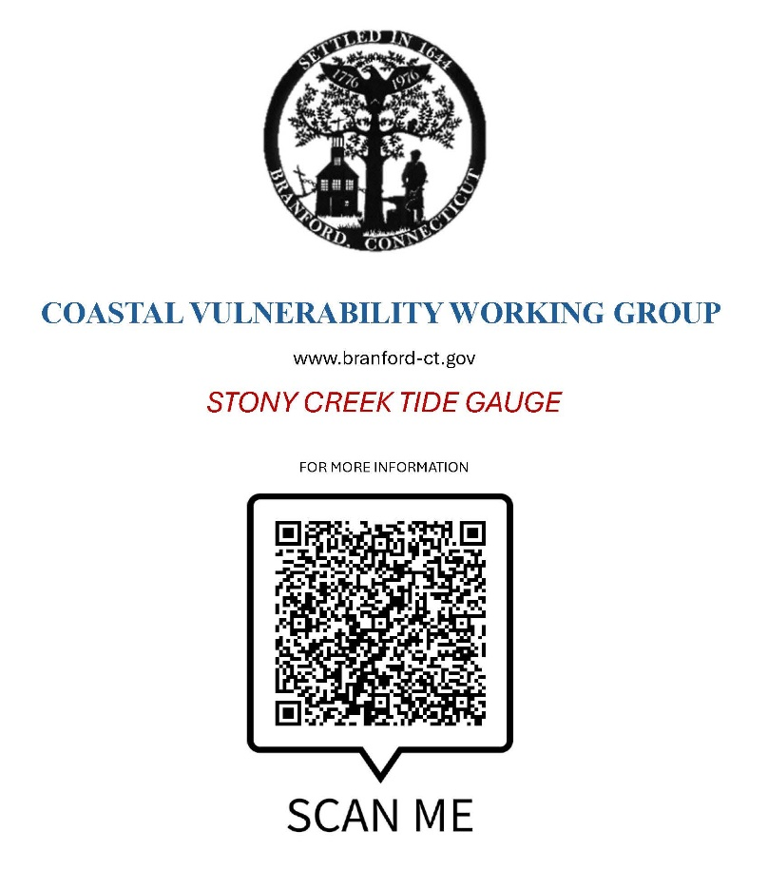
QR CODE IDENTIFICATION PLAQUE
BRANFORD COASTAL VULNERABILITY WORKING GROUP

Slide 20
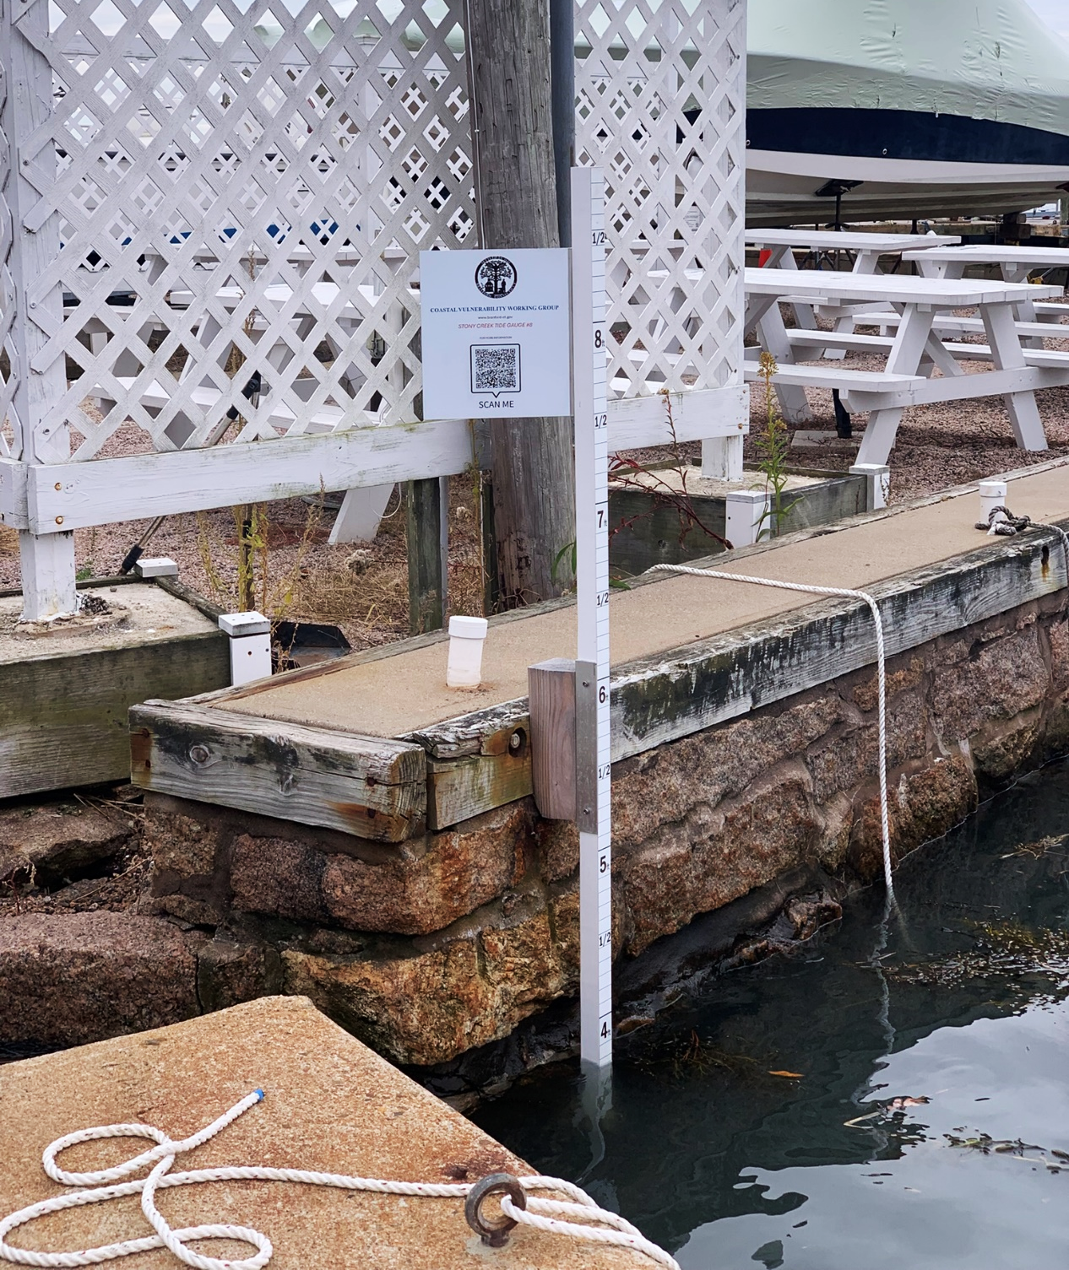
BRANFORD COASTAL VULNERABILITY WORKING GROUP

Slide 21
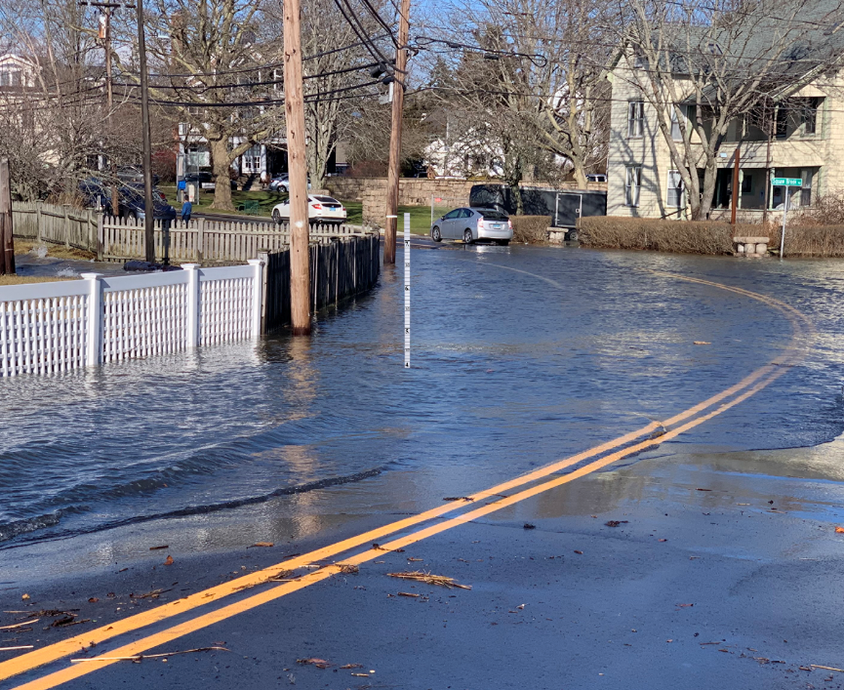
BRANFORD COASTAL VULNERABILITY WORKING GROUP

Slide 22
“STANDARD REPORT FORMAT”
Need to create a Standard Report Format to generate more useful reports
Need to train reporters on how to follow the format
Need for the site Administrator to be able to edit past reports to comply
BRANFORD COASTAL VULNERABILITY WORKING GROUP

Slide 23
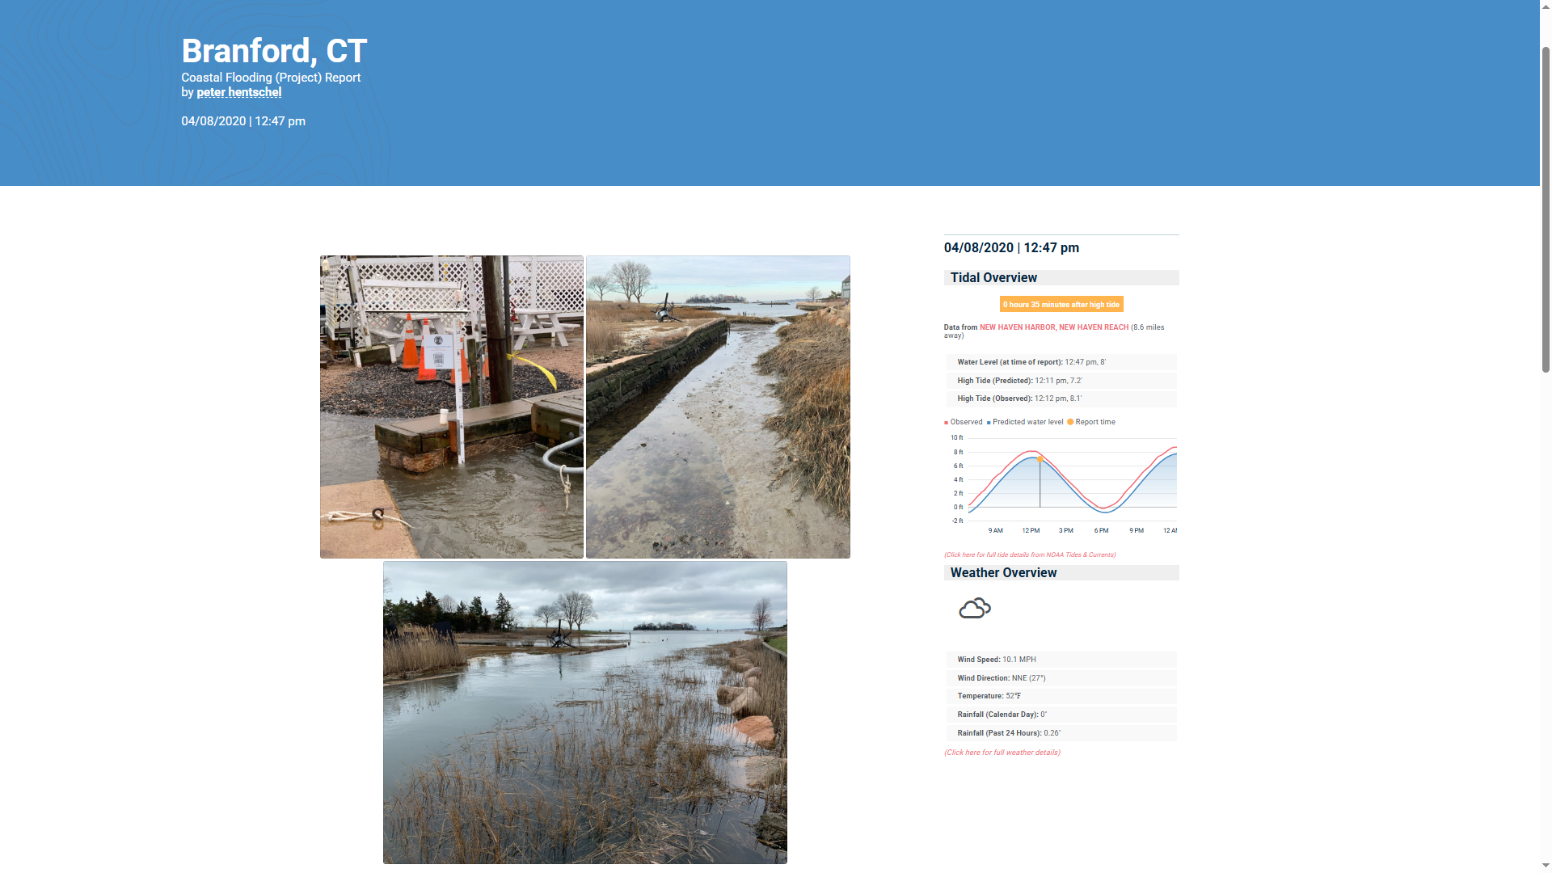
1 TIDE GAUGE
Calibrated to NAVD88
To establish the actual tide level at the time of the report
2 STREET MAP
Satellite image clarifying the location of the report and viewpoint of the image
3 BASELINE PHOTO
Baseline image - taken from a standardized viewpoint on a sunny day at a normal high tide
4 REPORT PHOTO
Report image - taken from the standardized viewpoint – this is the last image loaded
BRANFORD COASTAL VULNERABILITY WORKING GROUP

Slide 24
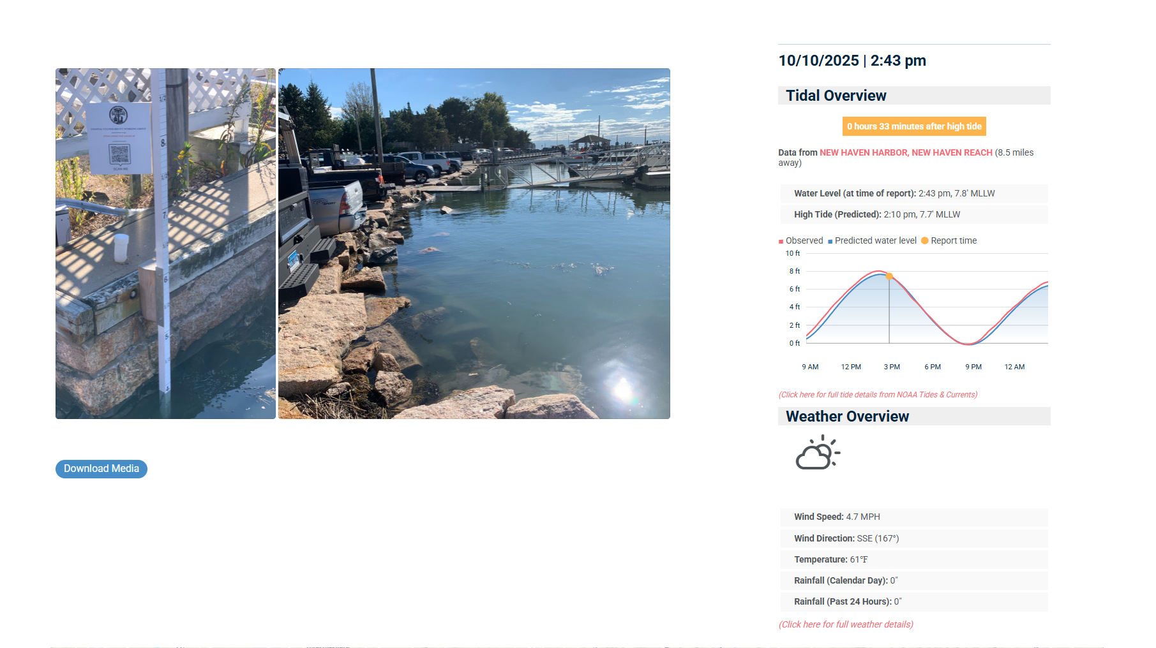
7.8’ MLLW – 3.42’ = 4.38’ NAVD88

Slide 25
1 TIDE GAUGE
Calibrated to NAVD88
To establish the actual tide level at the time of the report
2 STREET MAP
Satellite image clarifying the location of the report and viewpoint of the image
3 BASELINE PHOTO
Baseline image - taken from a standardized viewpoint on a sunny day at a normal high tide
4 REPORT PHOTO
Report image - taken from the standardized viewpoint – this is the last image loaded
BRANFORD COASTAL VULNERABILITY WORKING GROUP

Slide 26
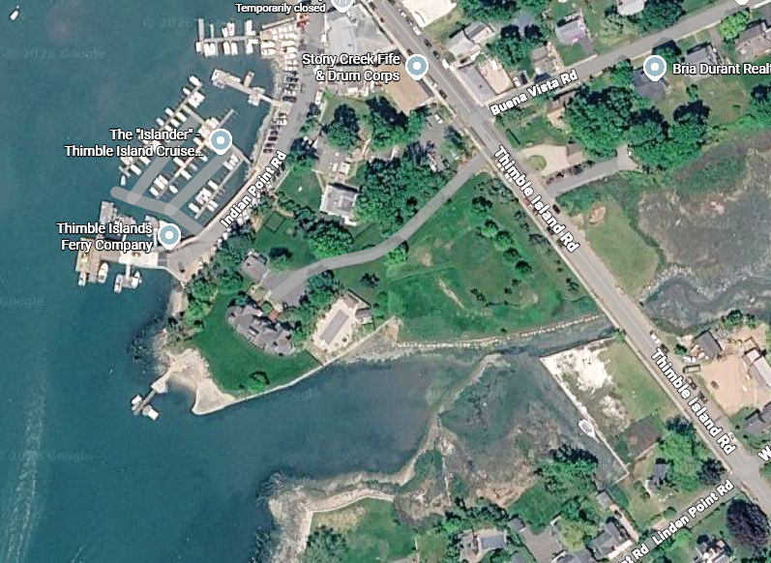
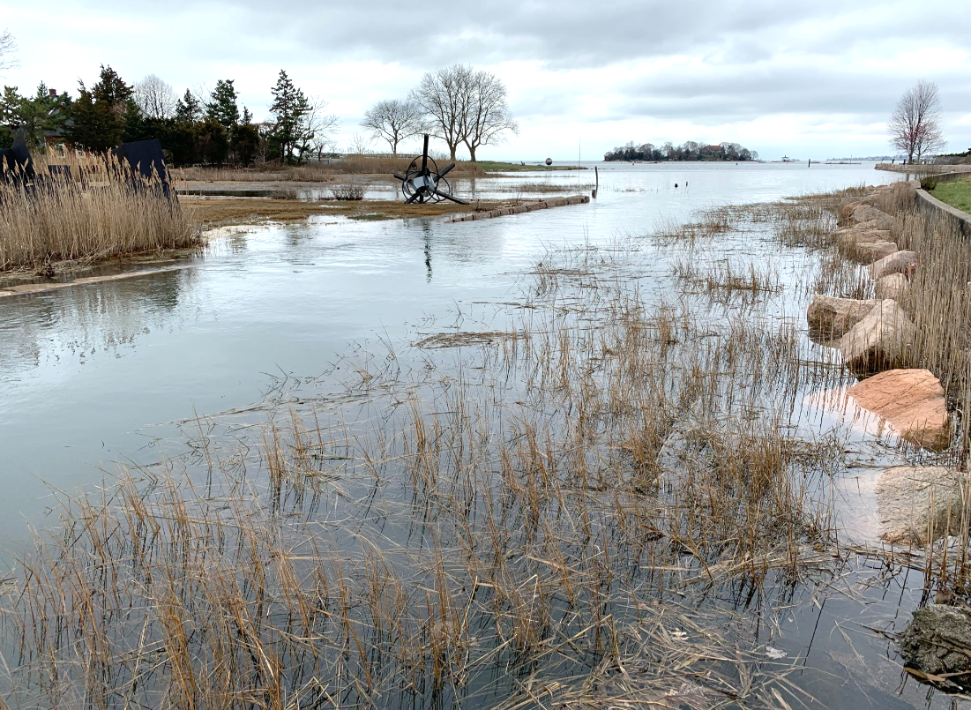
BRANFORD COASTAL VULNERABILITY WORKING GROUP

Slide 27
1 TIDE GAUGE
Calibrated to NAVD88
To establish the actual tide level at the time of the report
2 STREET MAP
Clarifying the location of the report and viewpoint of the image
3 BASELINE PHOTO
Baseline image - taken from a standardized viewpoint on a sunny day at a normal high tide
4 REPORT PHOTO
Report image - taken from the standardized viewpoint – this is the last image loaded
BRANFORD COASTAL VULNERABILITY WORKING GROUP

Slide 28
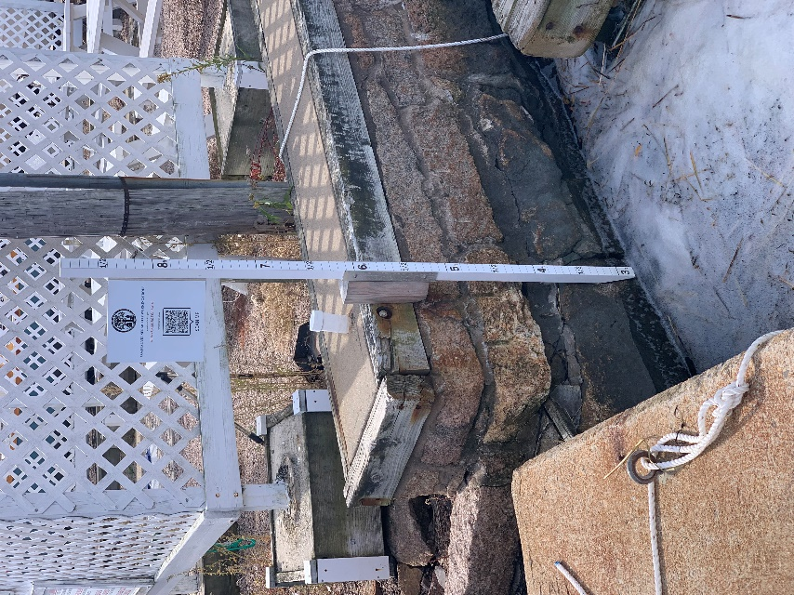
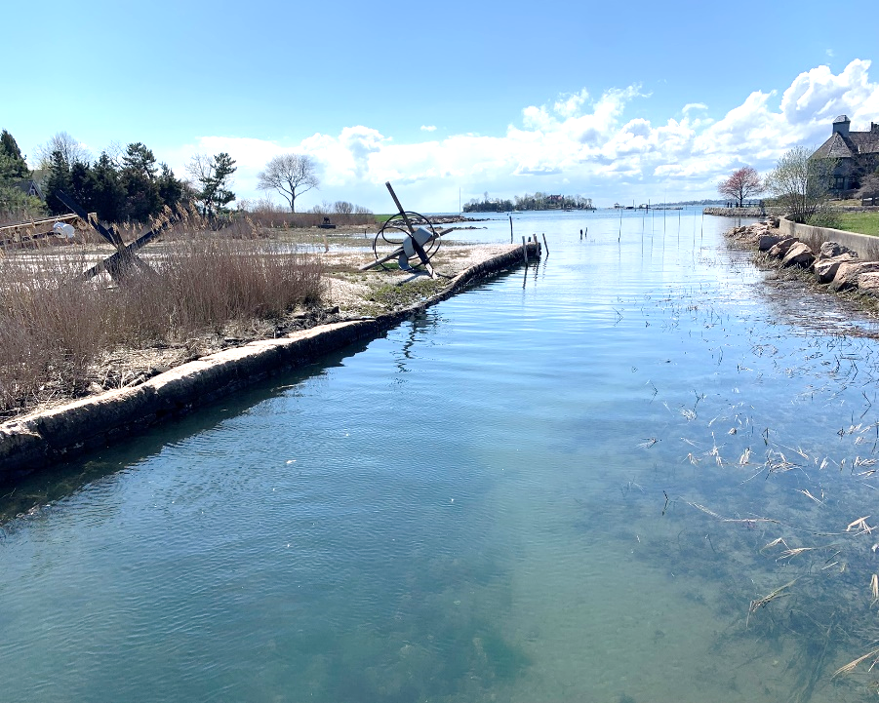
BRANFORD COASTAL VULNERABILITY WORKING GROUP

Slide 29
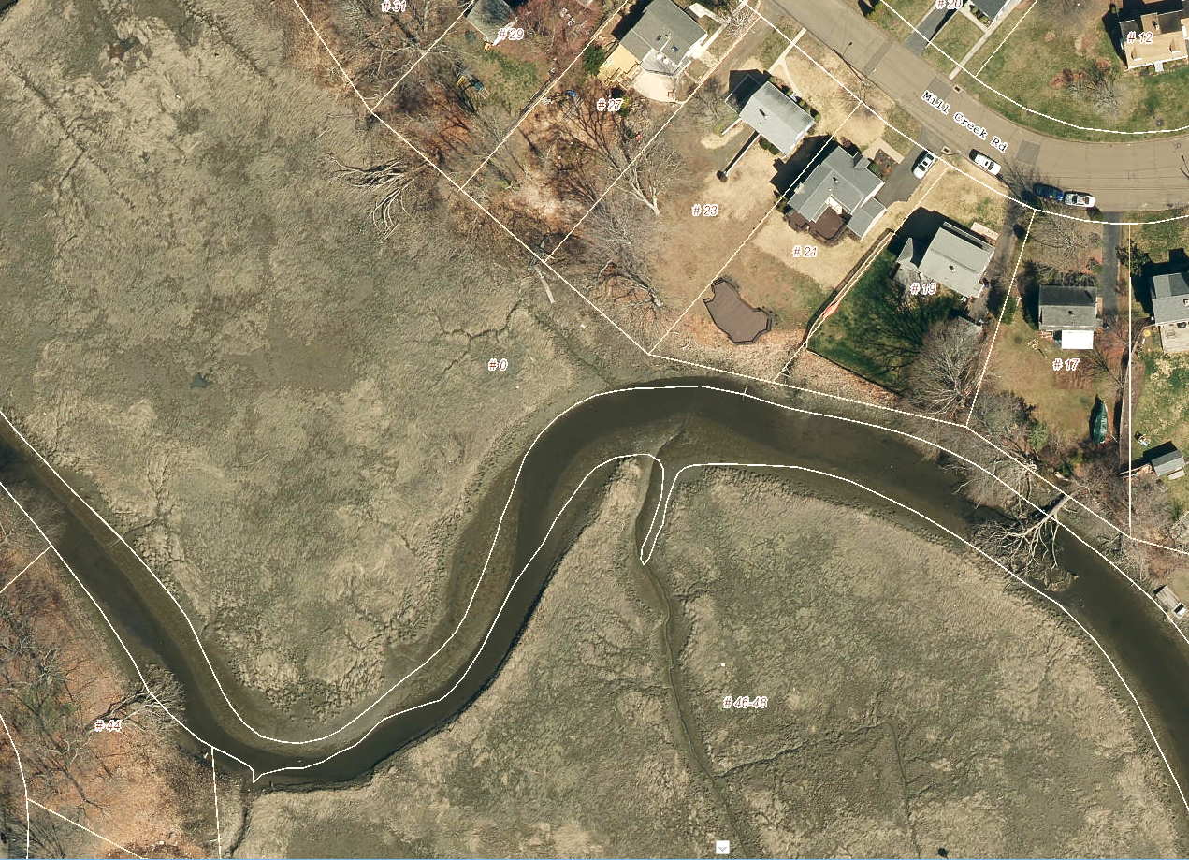
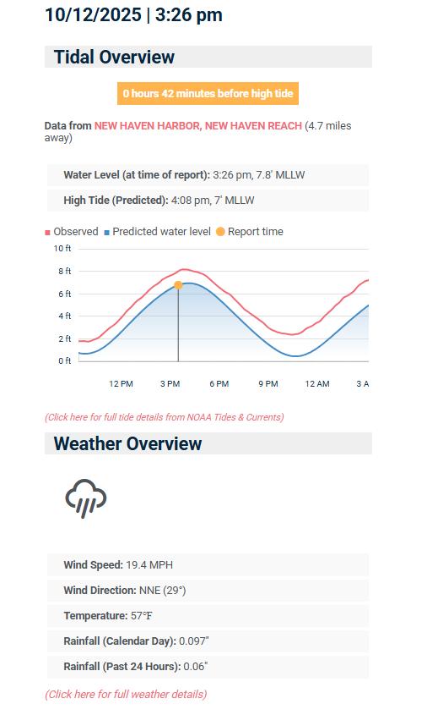
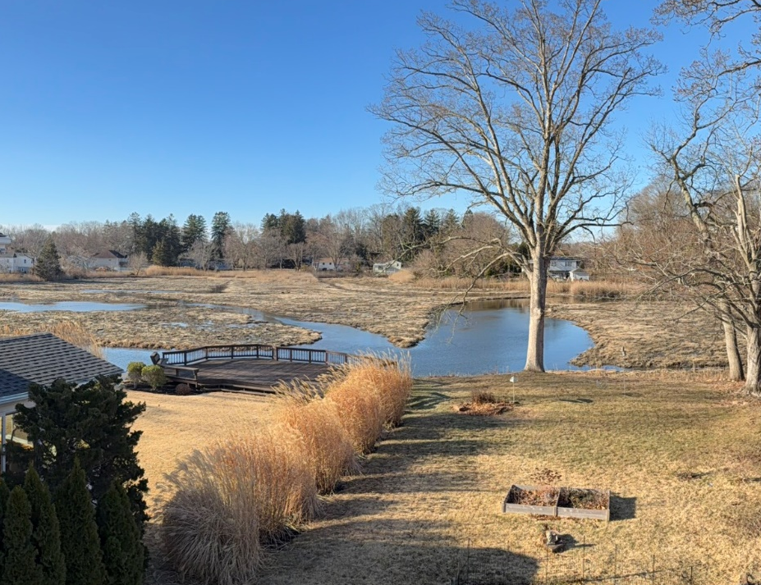
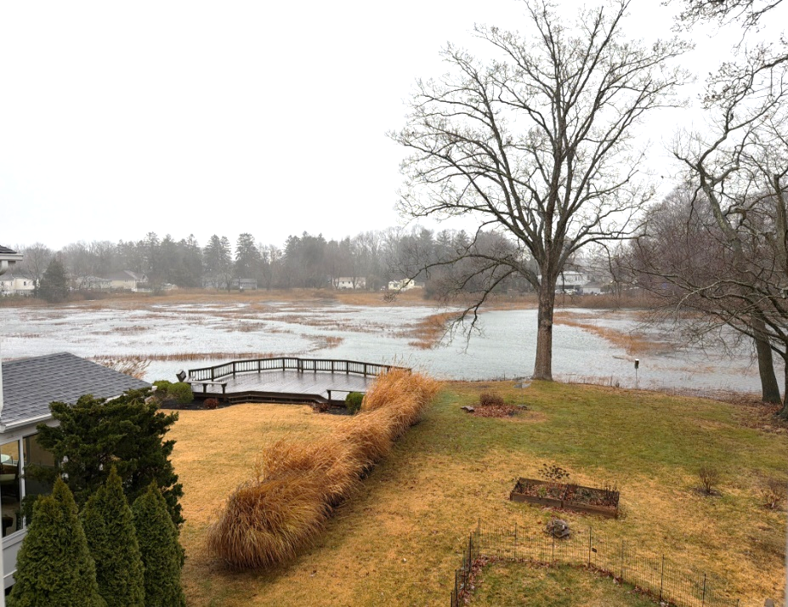
BRANFORD COASTAL VULNERABILITY WORKING GROUP

Slide 30
Challenges
Images of flooding without a baseline image for comparison are difficult to evaluate
Flood reports with tide level elevations alone are difficult to relate to land surveys
NAVD88 levels can be established by subtracting (3.42) from the reported Tide levels
An actual local gauge would be better
Photo reports at given location are be easier to compare if all take from same viewpoint
Need to apply standards to report collection
BRANFORD COASTAL VULNERABILITY WORKING GROUP

Slide 31
App Improvements
Addition of NAVD88 tide level calculations in the tide-level graph
Ability for the site Administrator to edit reports after they are posted
Ability to tag report types for later searches – flooding, storm damage, etc.
Mapping of reports to be selectable by type, date, etc.
Each community should have a separate landing page
BRANFORD COASTAL VULNERABILITY WORKING GROUP

Slide 33
CT MYCOAST
Annual Meeting w Presentation by Branford CVWG
When: 1 p.m. April 22
What: Annual recap, update on municipal activities and next steps for coastal Connecticut
Link to join Webex Event: https://uconn-cmr.webex.com/wbxmjs/joinservice/sites/uconn-cmr/meeting/download/b85557e464294665a8dda3e02c0c8006?MTID=m0811197eafeb03fe06ce4292213a05dd
Register by clicking here

Slide 35
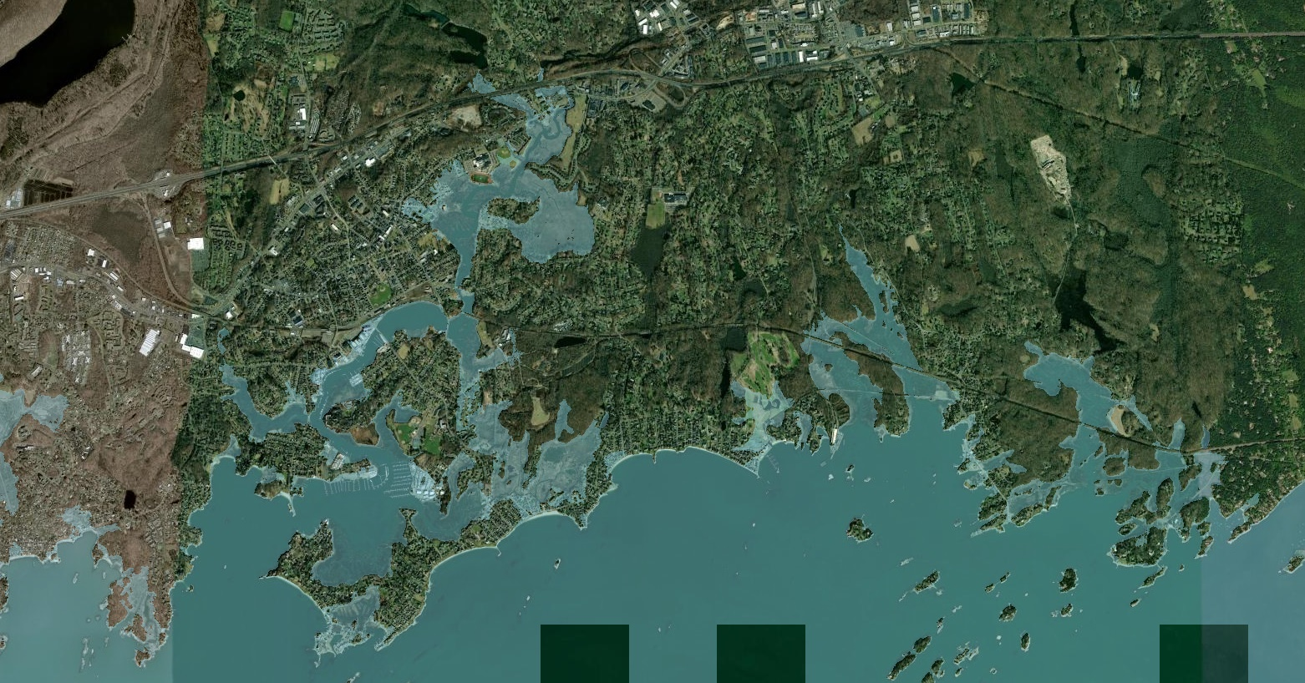



Slide 36
