Slide 1
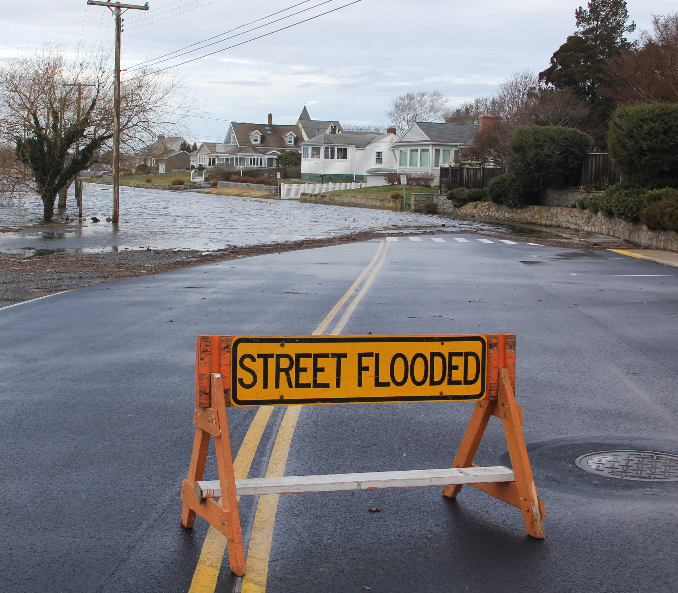
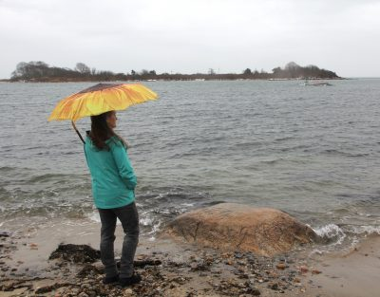
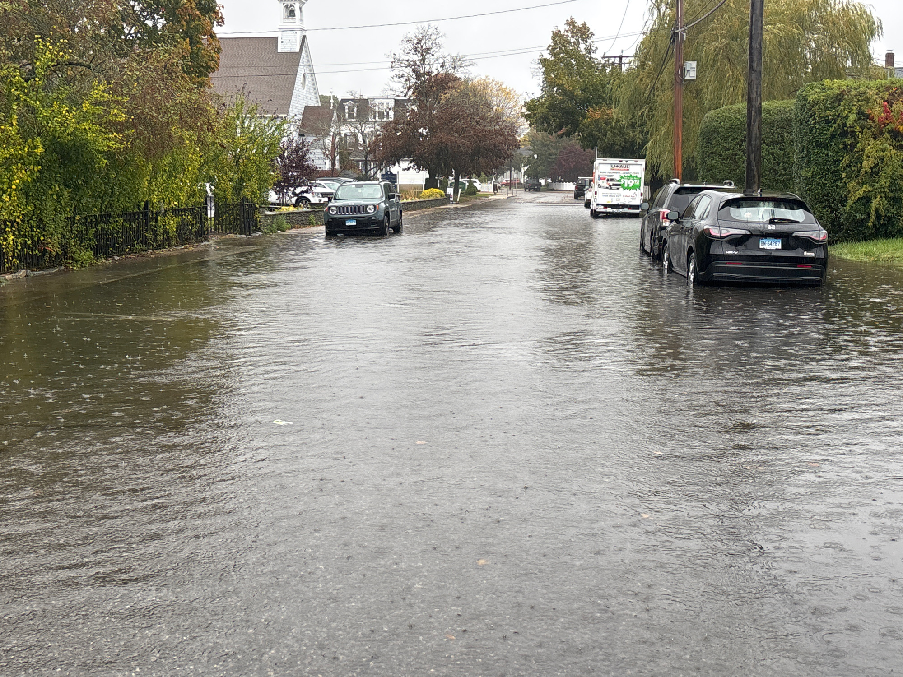

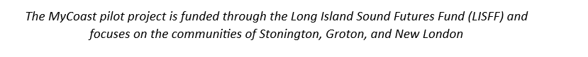
MyCoast Connecticut A pilot project for New London, Groton, and Stonington
Notes:
Photo Credit – S. Schechter (Groton), J. Orchardo (Groton), K. Lund (Groton)
https://mycoast.org/reports/222866
https://mycoast.org/reports/222716

Slide 2


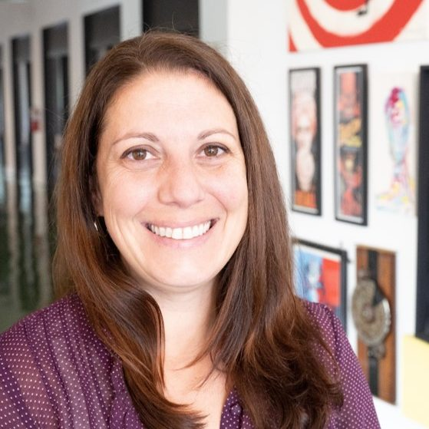
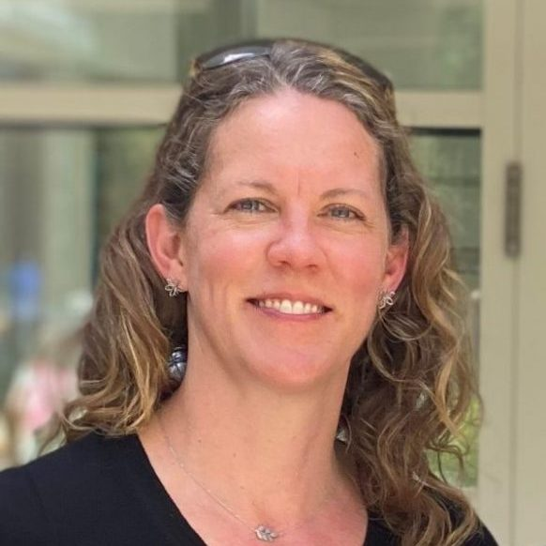
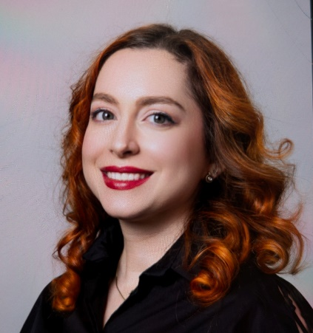

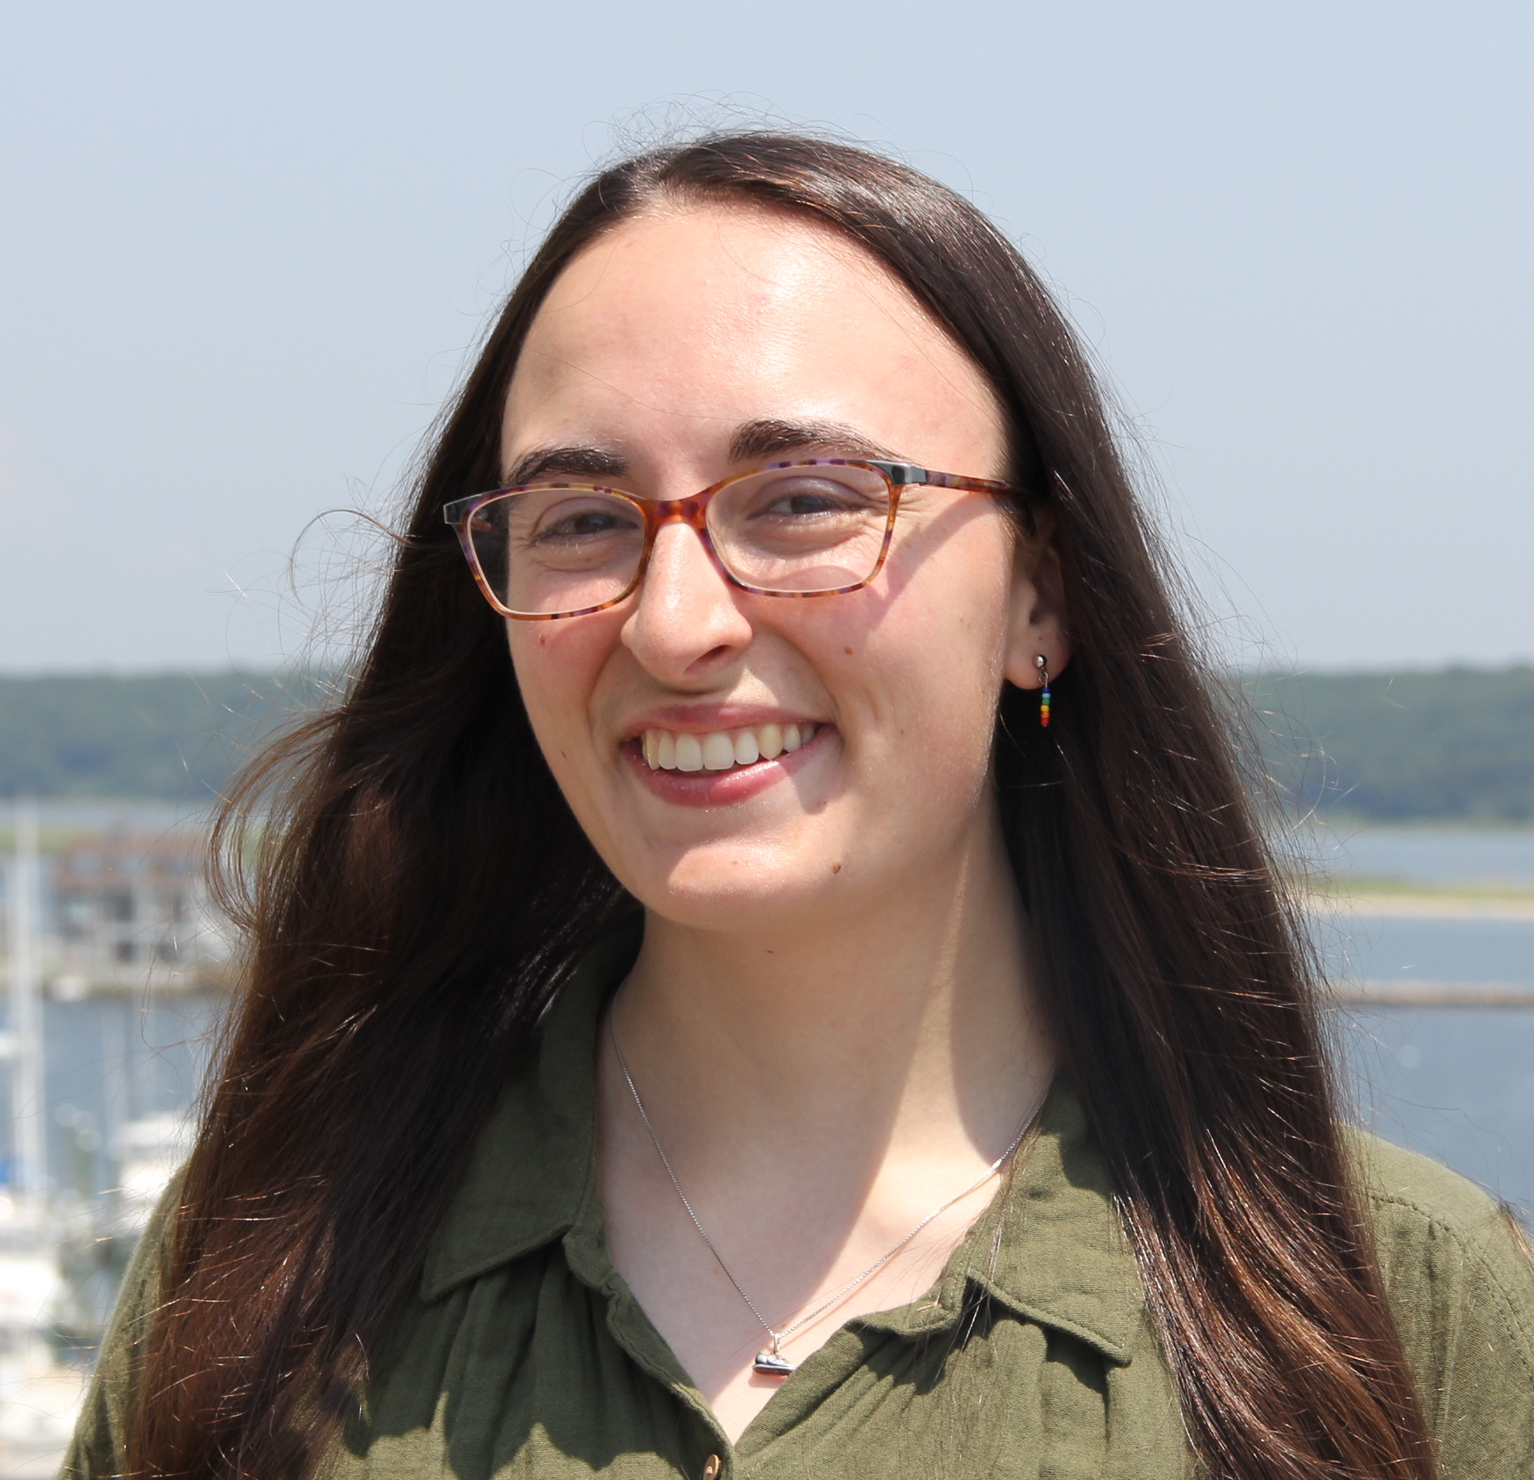
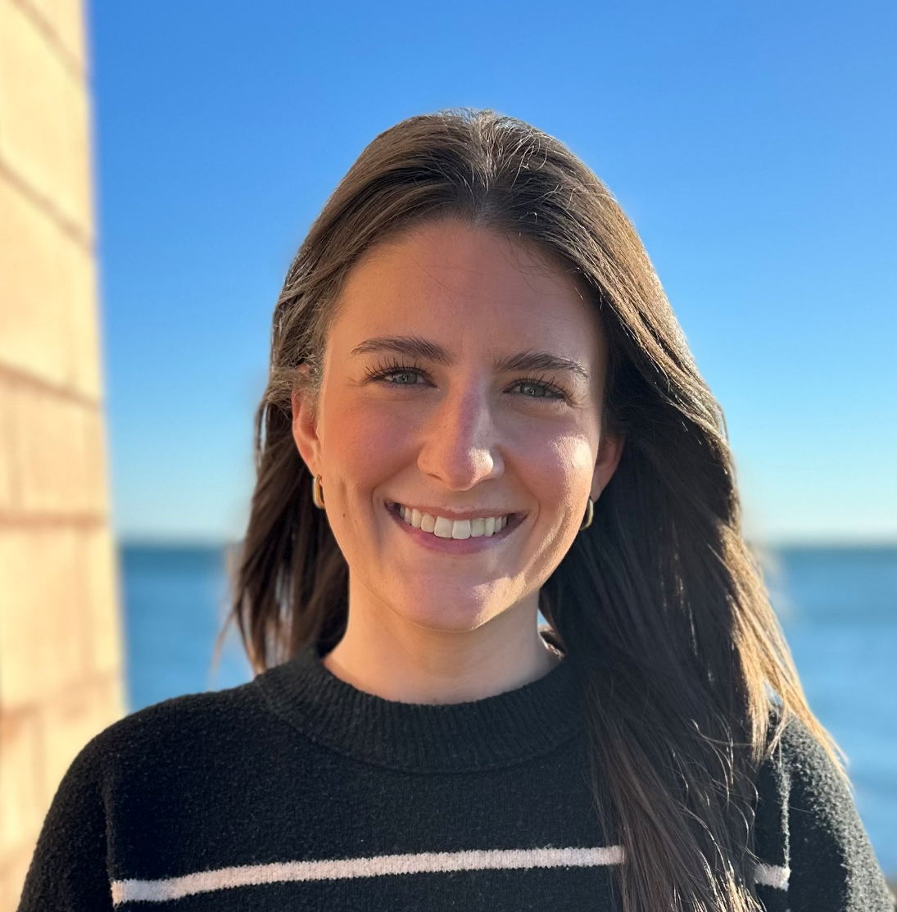
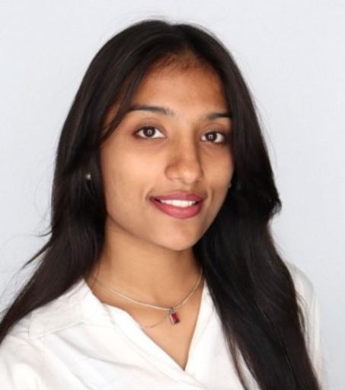
Project Team
Larissa Graham Education Coordinator
Katie Lund Training Coordinator
Yaprak Onat
Assoc. Director of Research
Sarah Schechter, Project Lead
Asst. Extension Educator – Sustainable & Resilient Communities
Falyn McQuarrie Assistant Coordinator
Hiral Choksi
Graduate Assistant
Notes:
Katie Passes to Sarah
Everyone introduces themselves

Slide 3

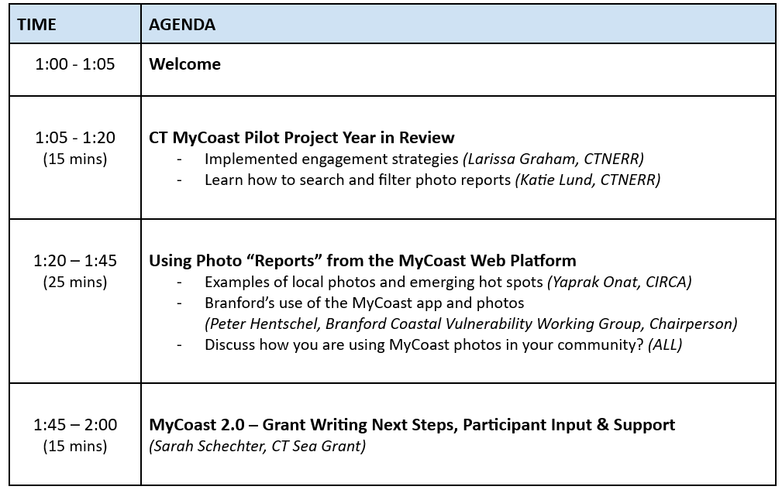
Webinar: April Showers Bring…MyCoast!

Slide 4
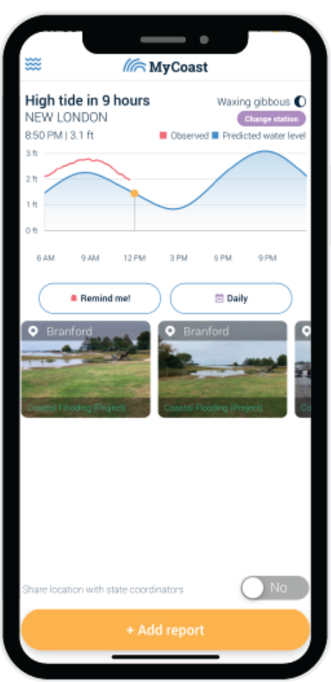
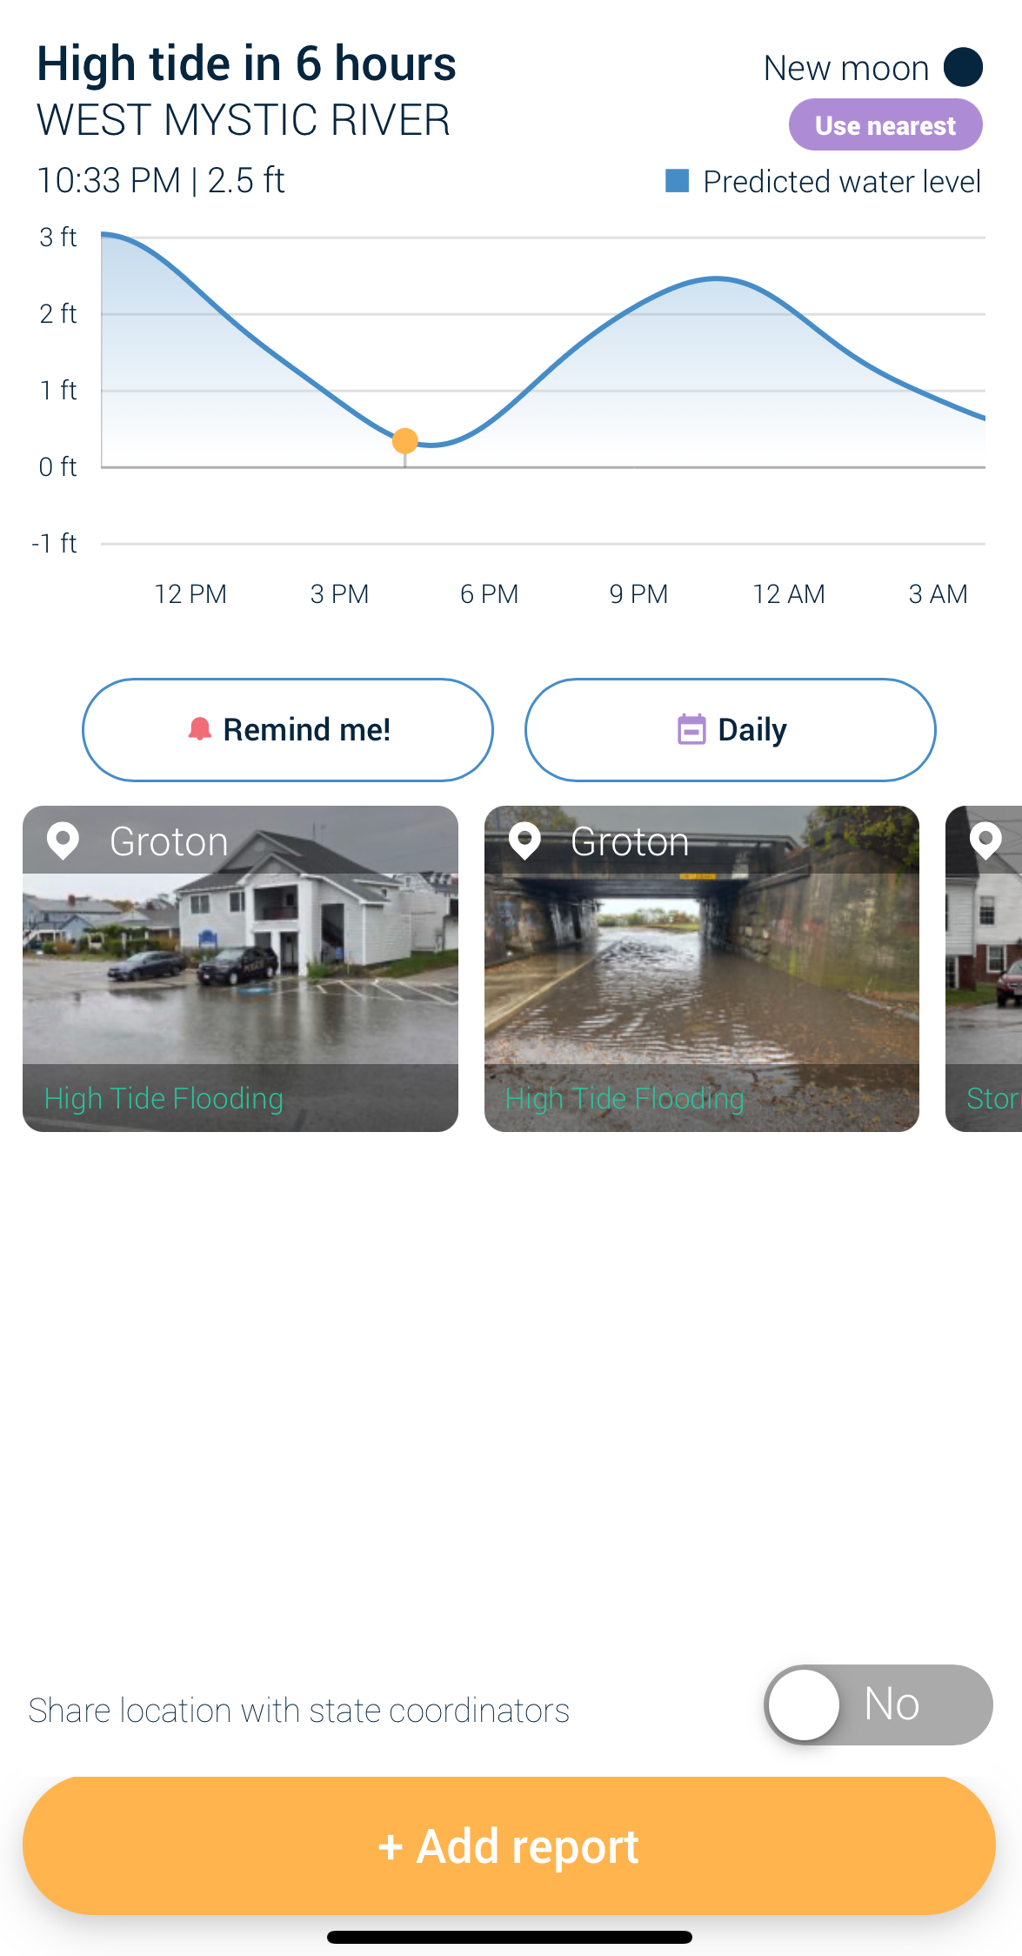

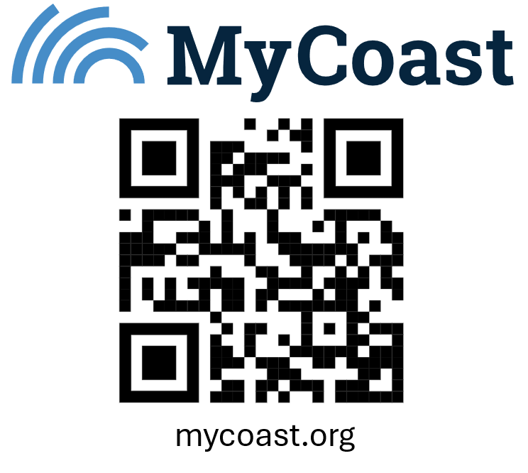
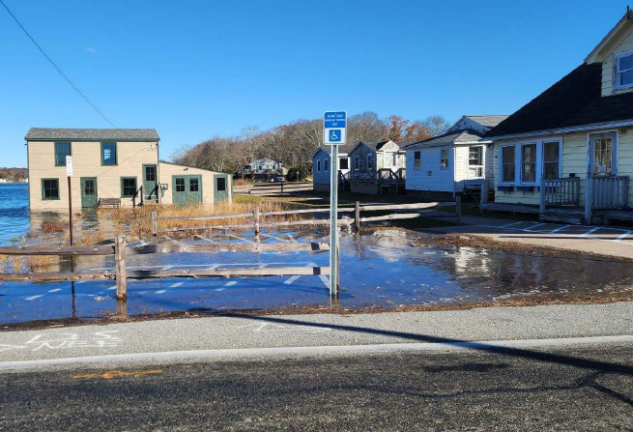
Inform state and local resilience planning
Identify areas repeatedly affected by flooding
MyCoast is a free, user-friendly app for people to upload photos of coastal flooding, storm damage, and extreme high tide events.
Raise public awareness about flooding
How are we using MyCoast?

Slide 5
Engagement Strategies
Audience / users
Data users
Data collectors
(municipal & state agency staff, residents & businesses)

Slide 6
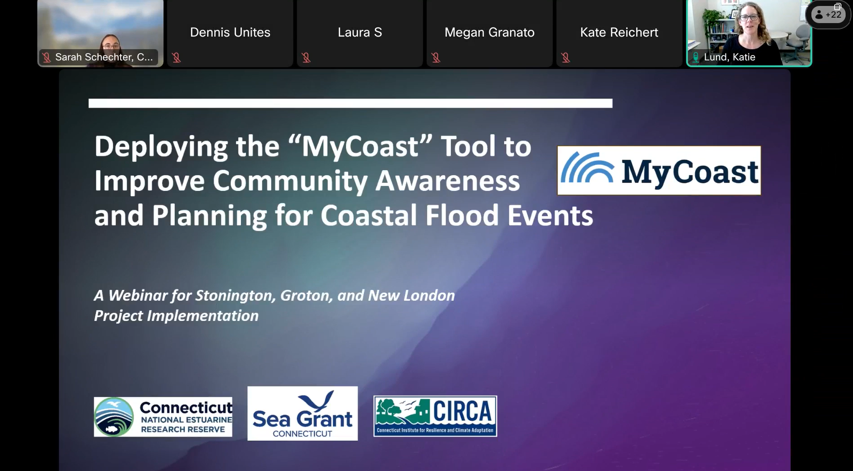
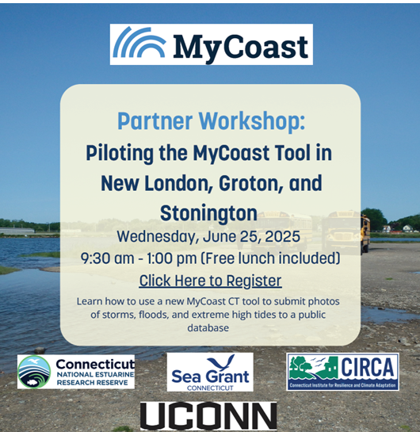
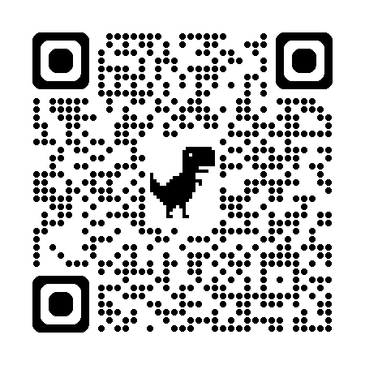
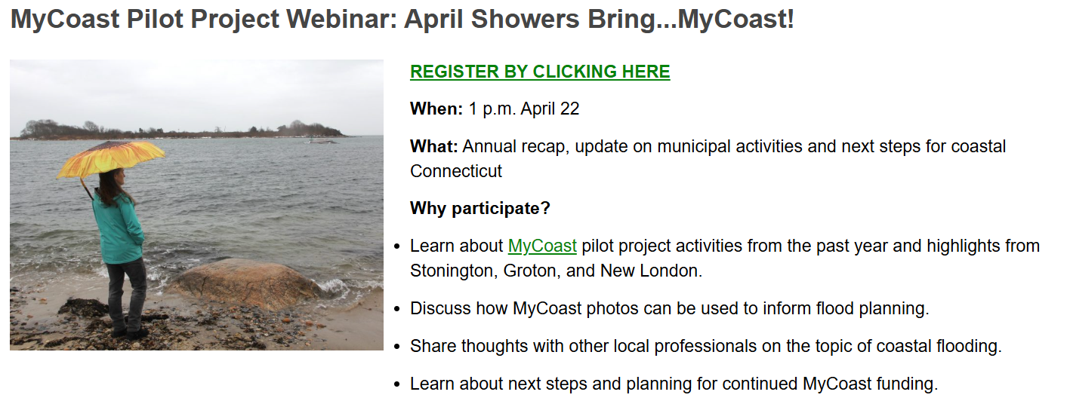
Engagement Strategies
Promoting the MyCoast app
April 2025
Webinar
June 2025
Workshop
TODAY
Apr 2026
Webinar
Link to recordings

Slide 7
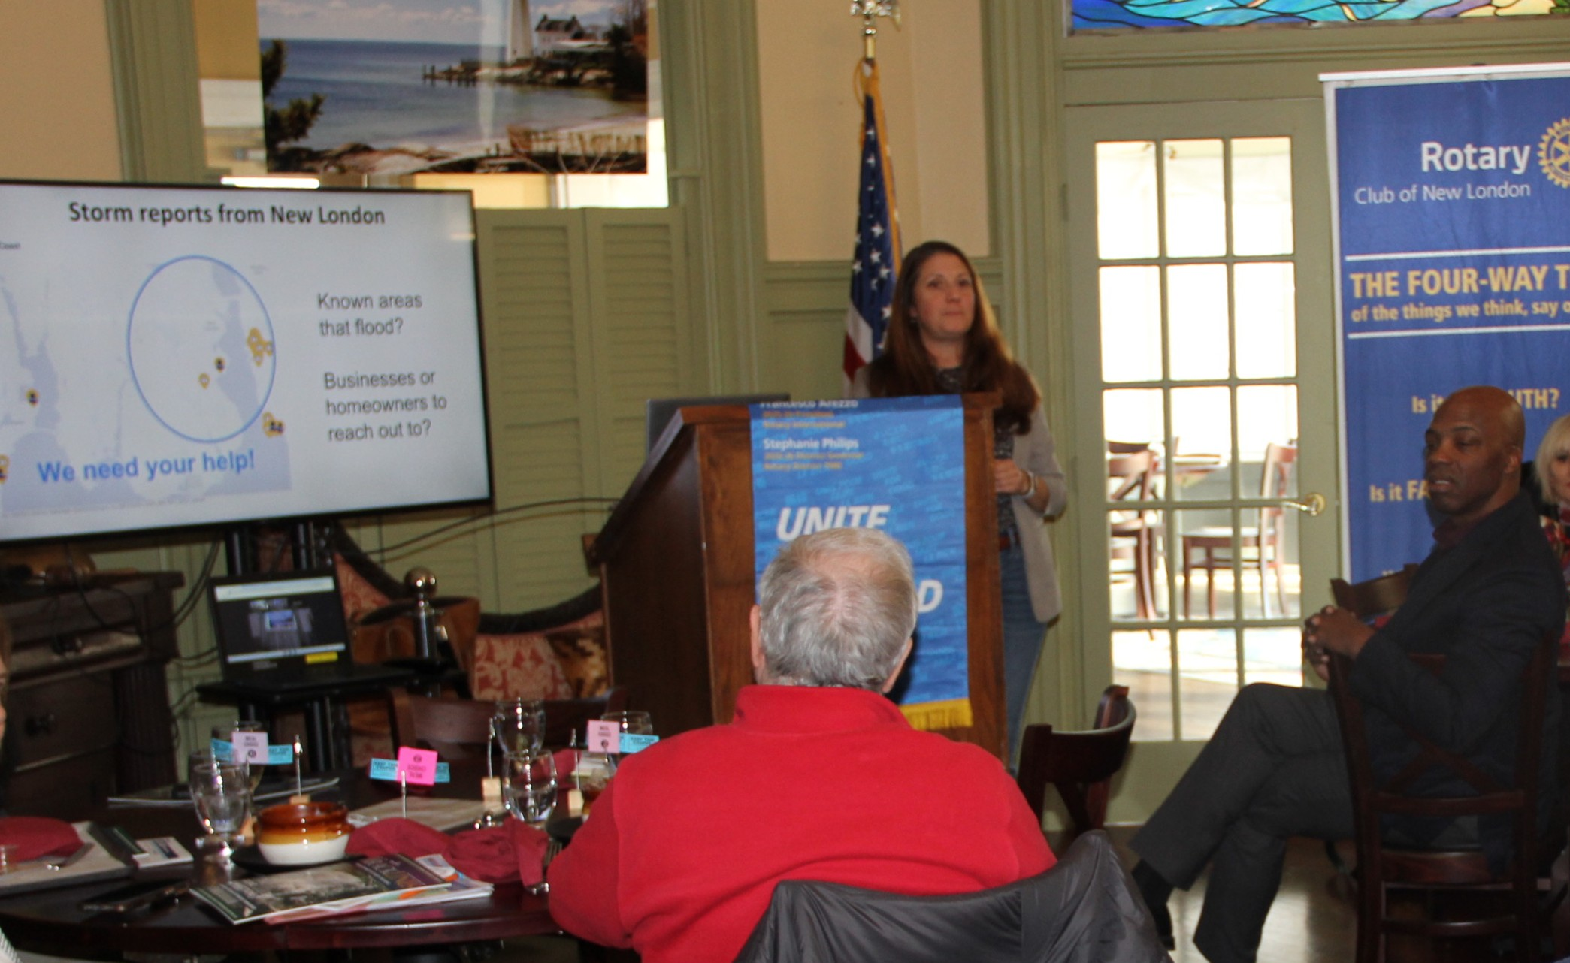
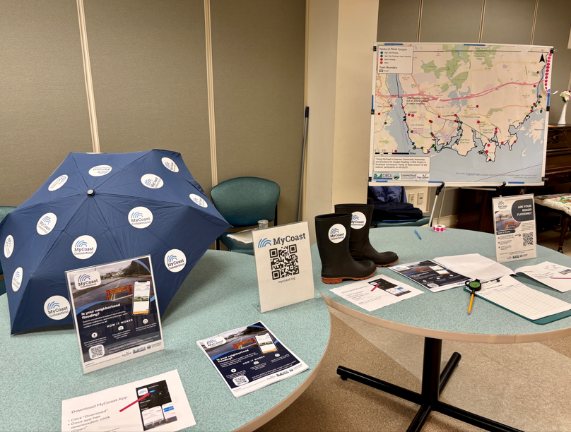
Engagement Strategies
Promoting the MyCoast app
Meetings & Presentations

Slide 8
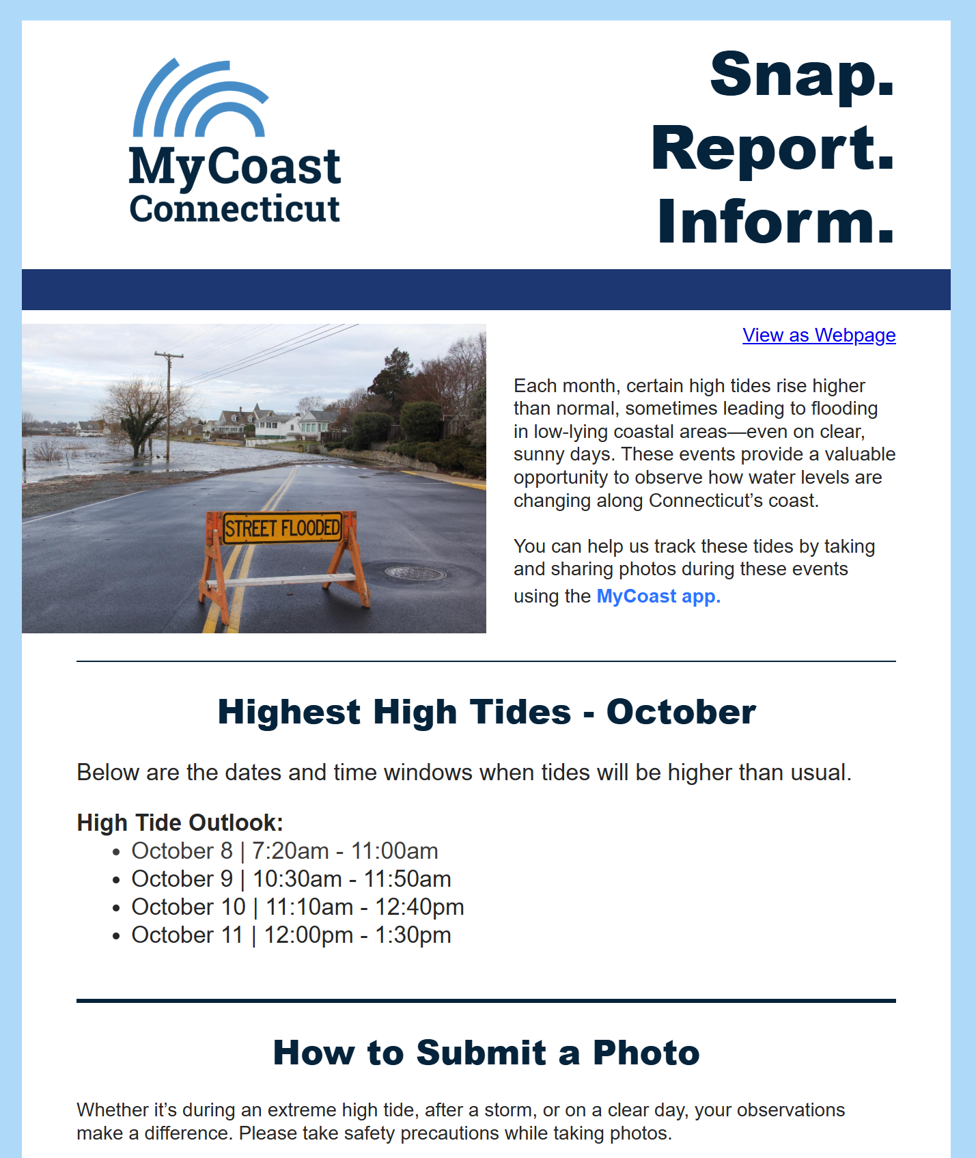
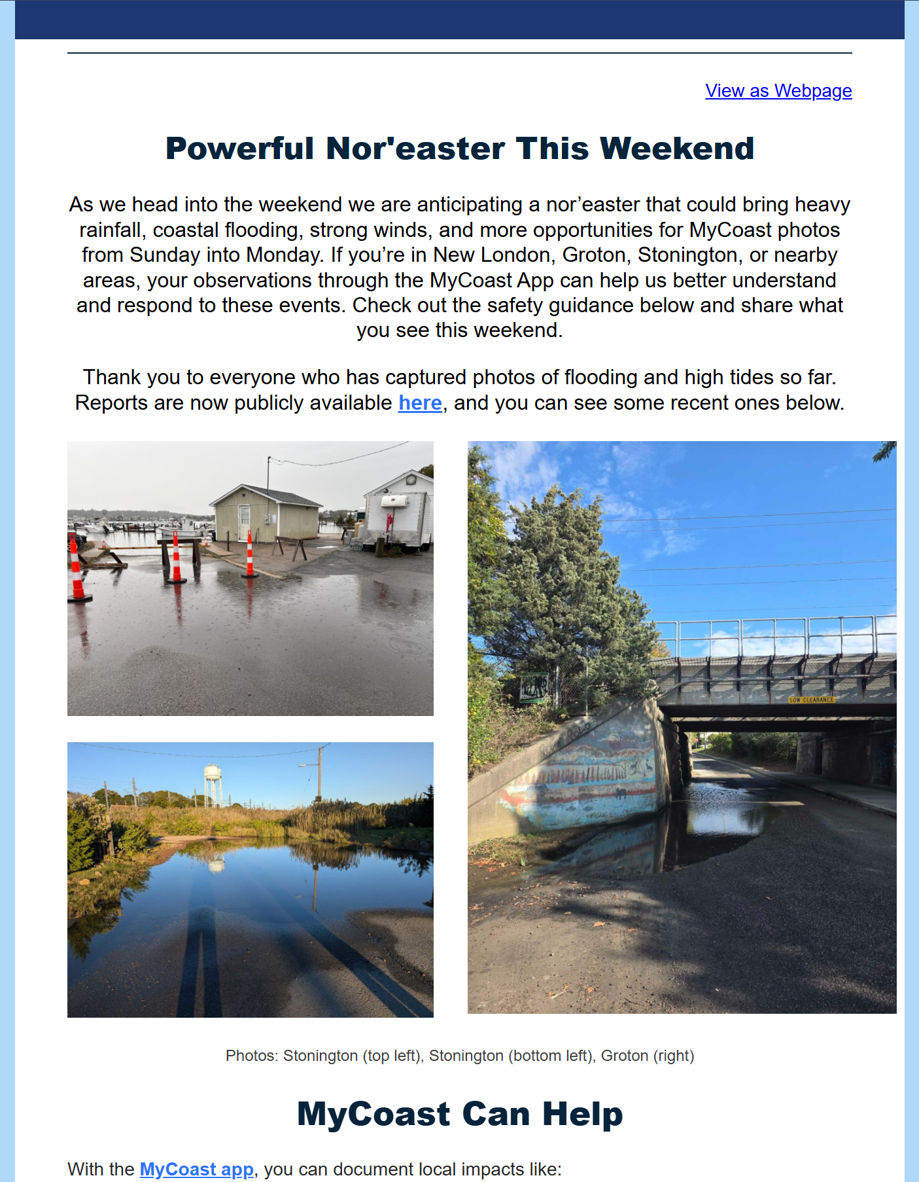
Engagement Strategies
Direct email alerts

Slide 9
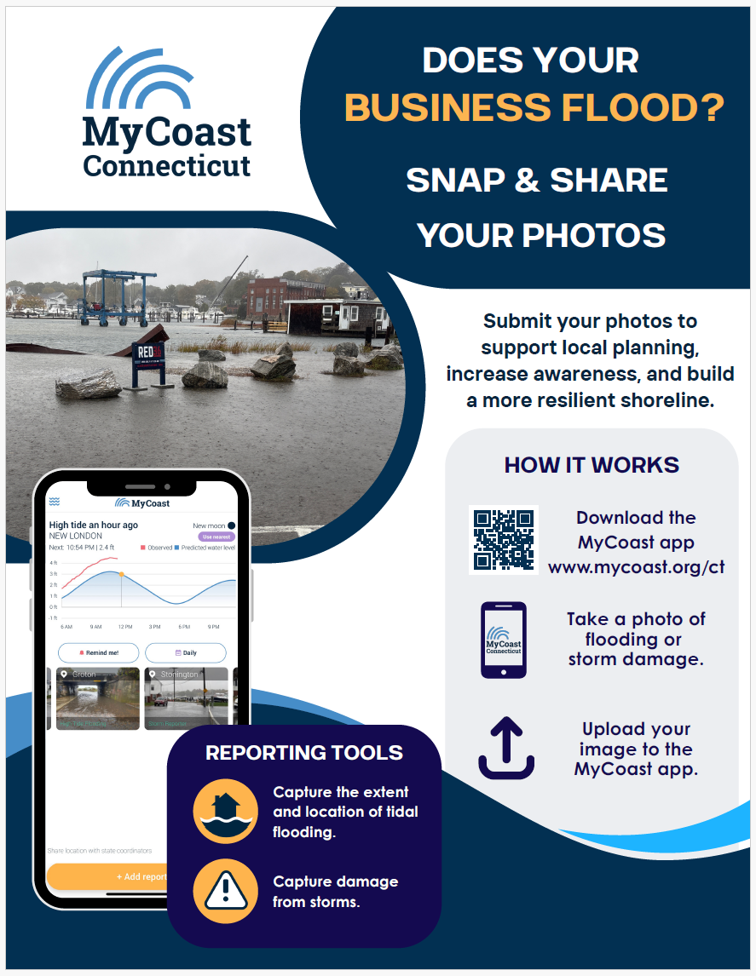
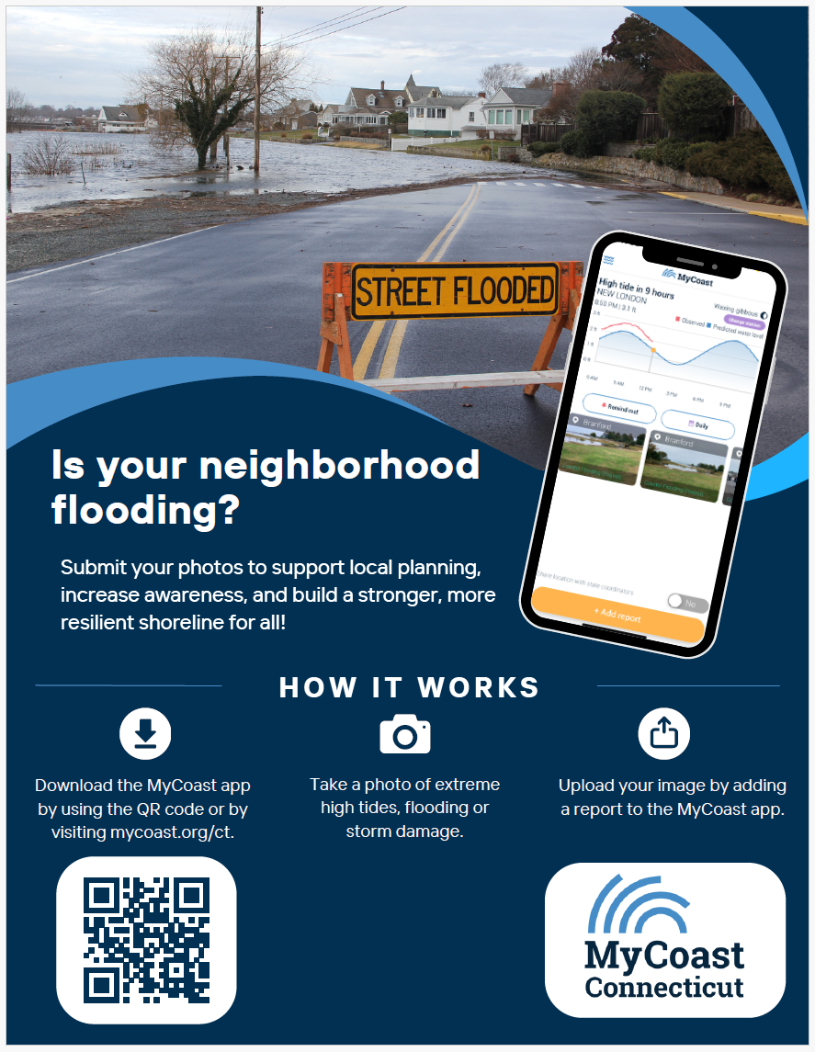
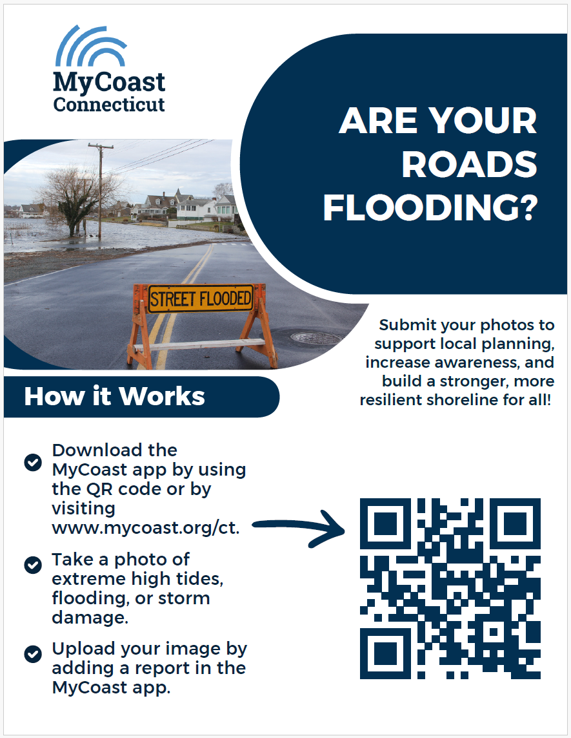
Engagement Strategies
Recruiting photo-takers

Slide 10
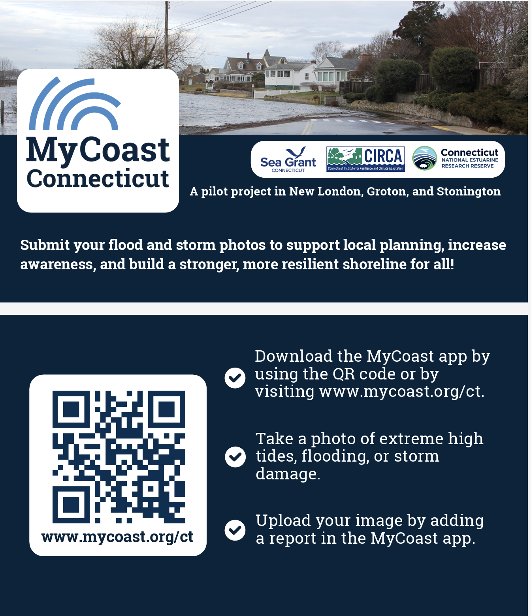
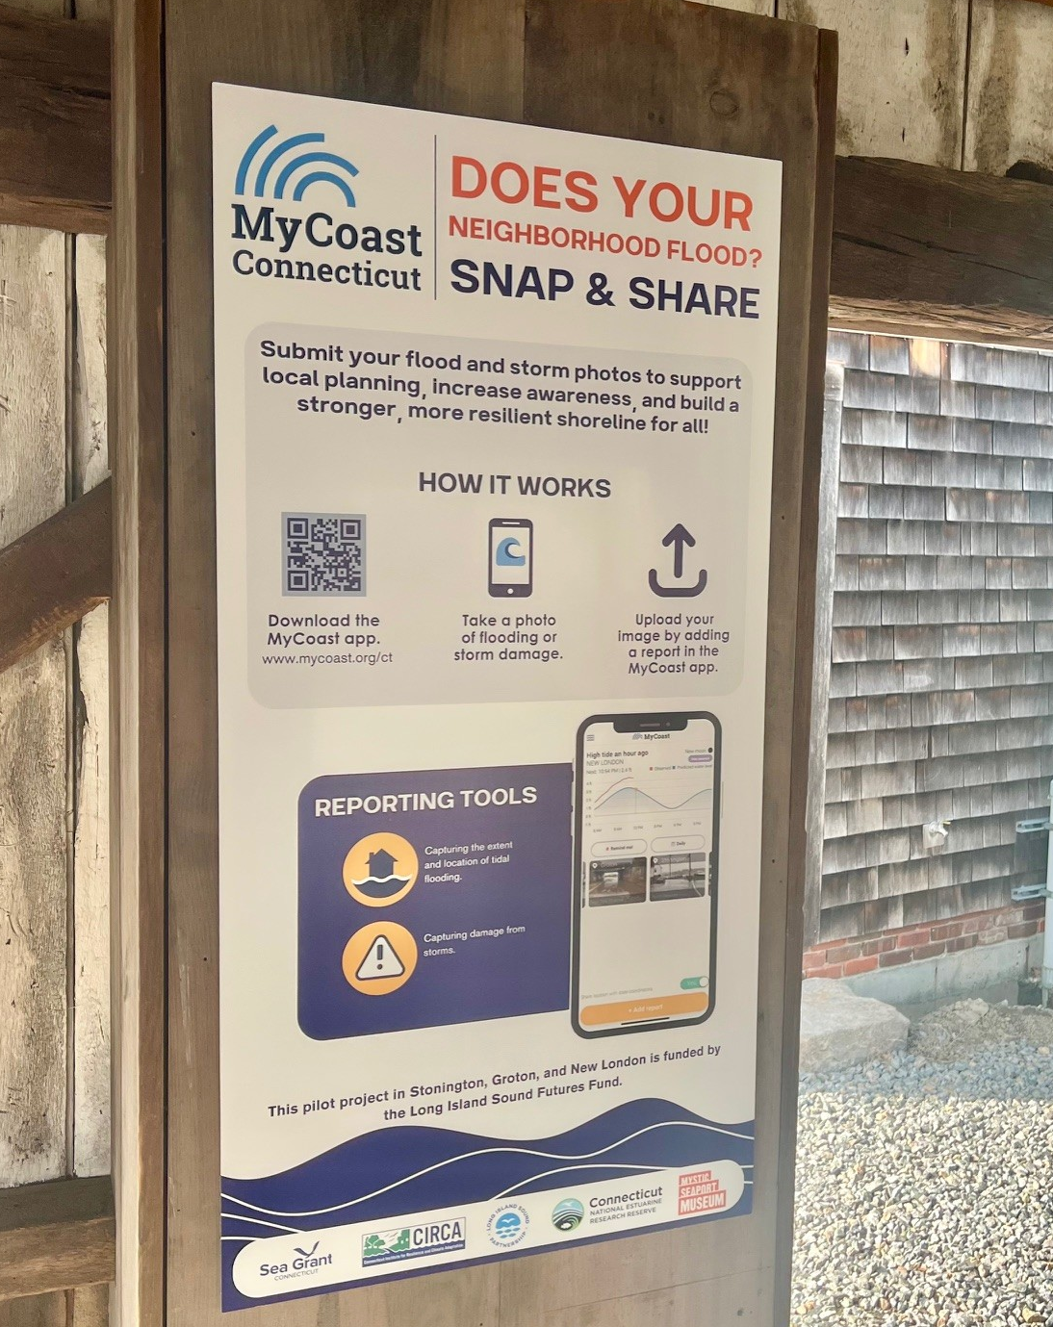


Engagement Strategies
Recruiting photo-takers
Business Cards
Sign @ Mystic Seaport
Stickers

Slide 11
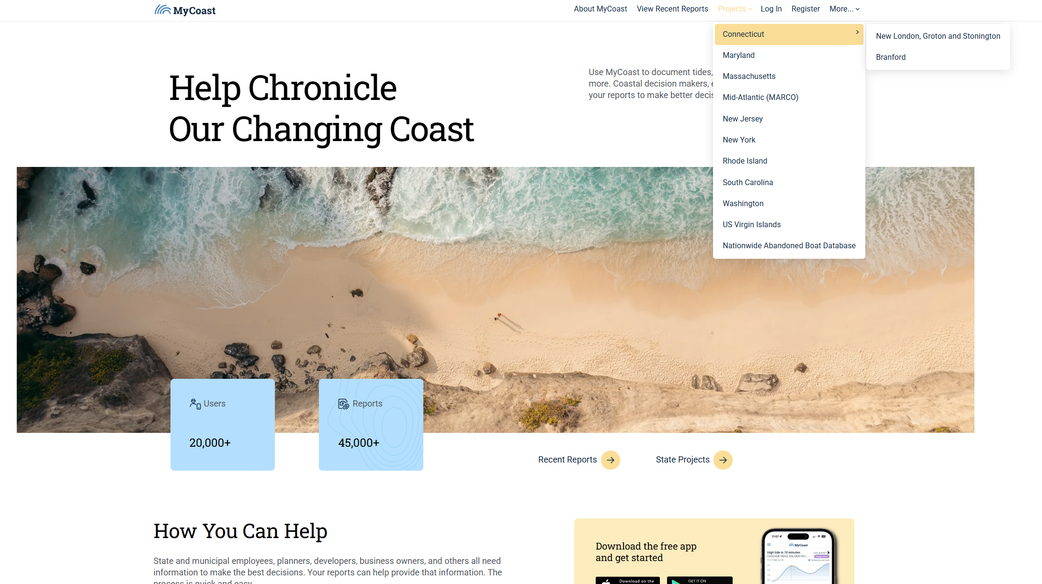
https://mycoast.org/
Katie’s slides

Slide 12
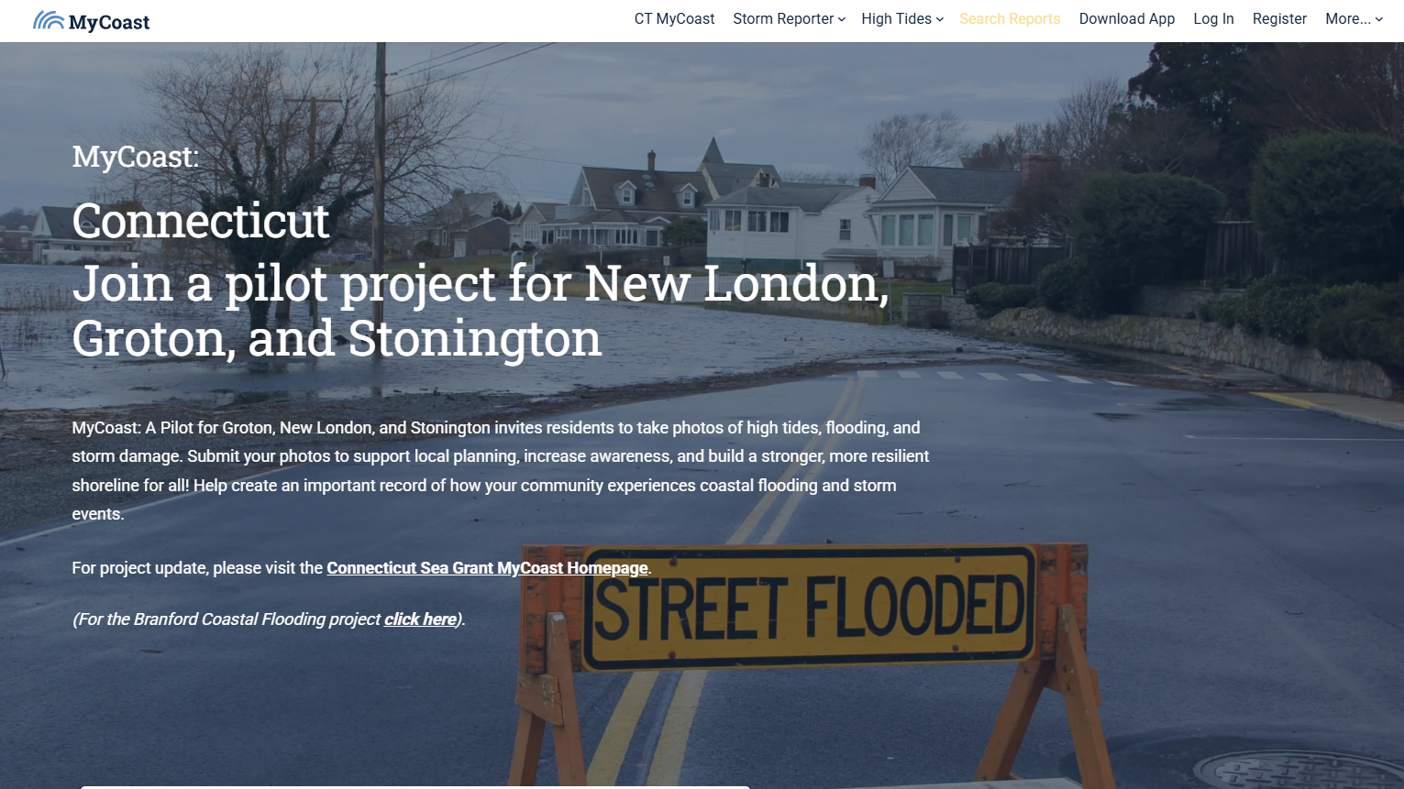

Slide 13
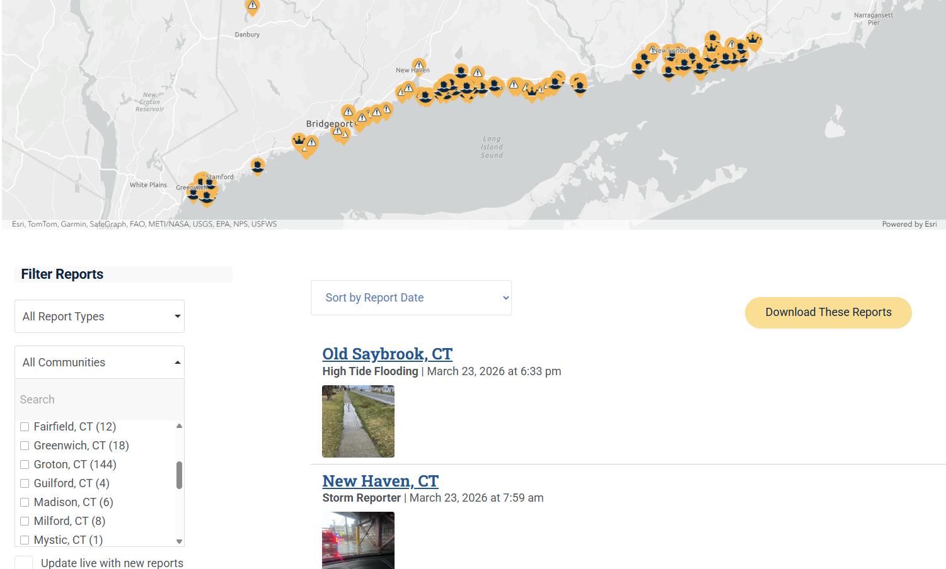

Slide 14
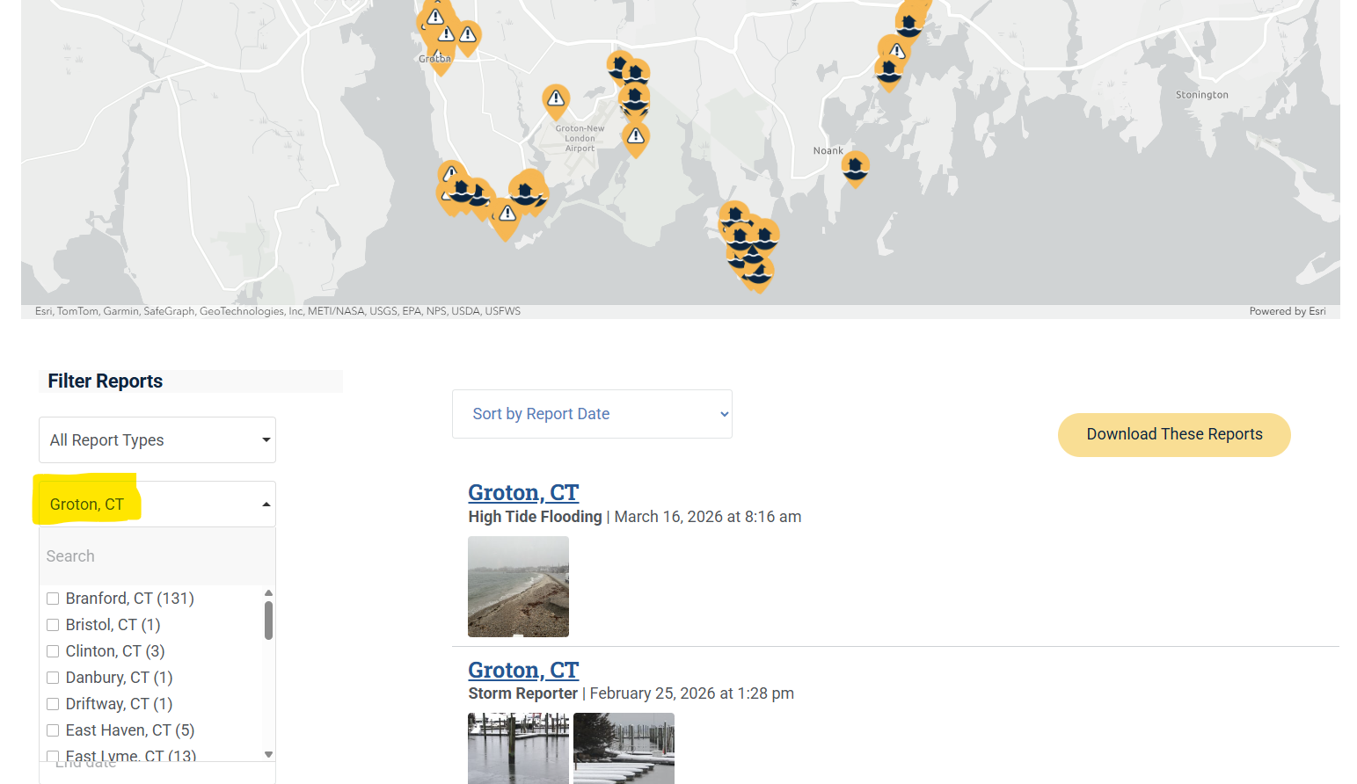

Slide 15
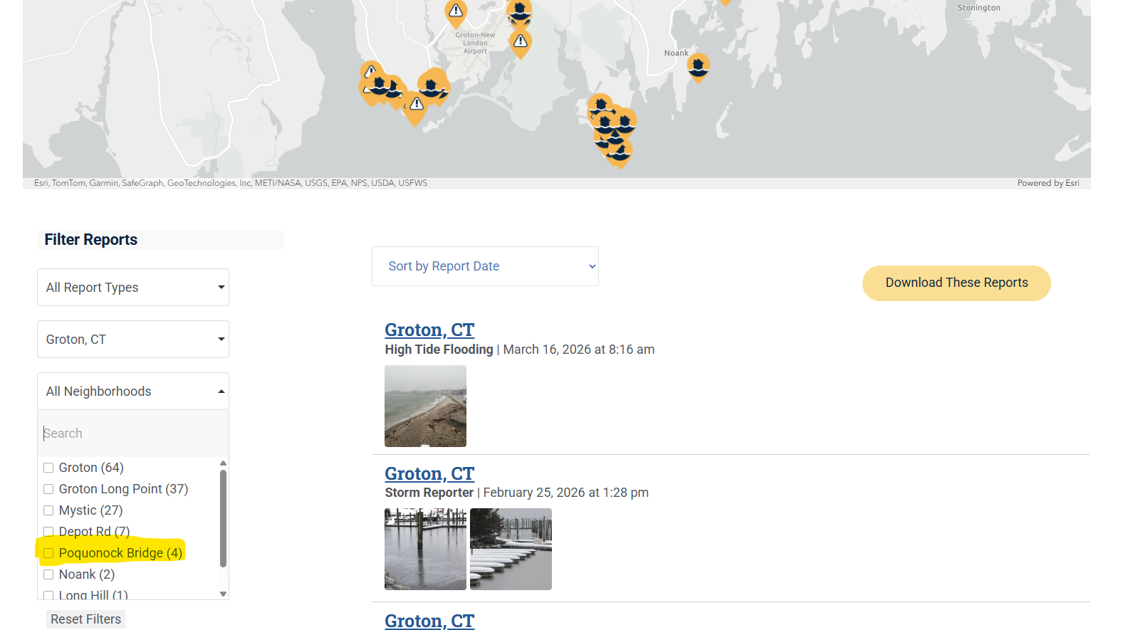

Slide 16
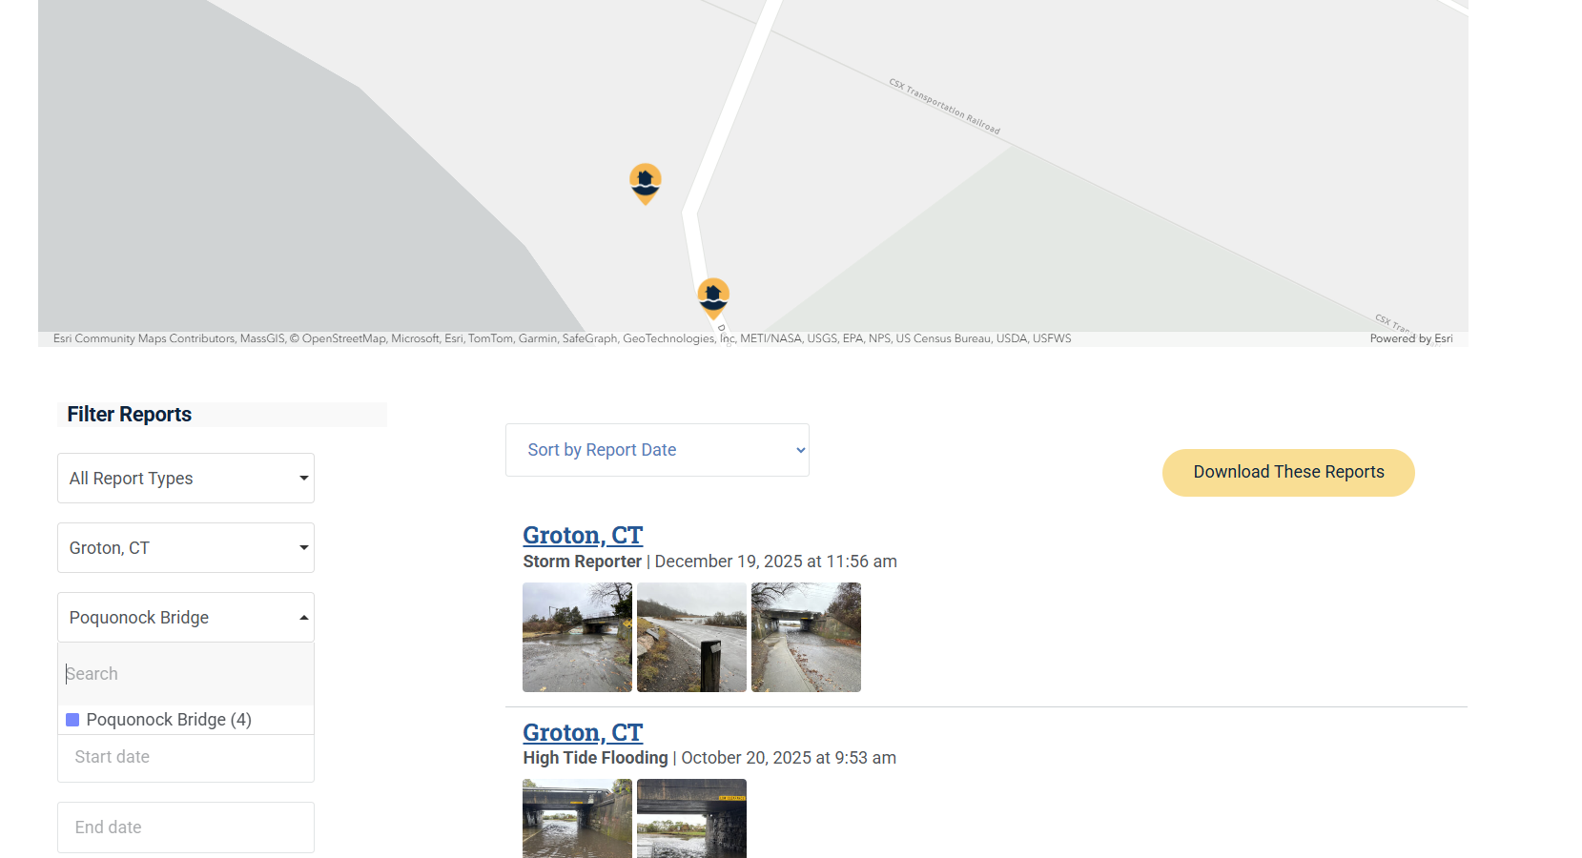

Slide 17
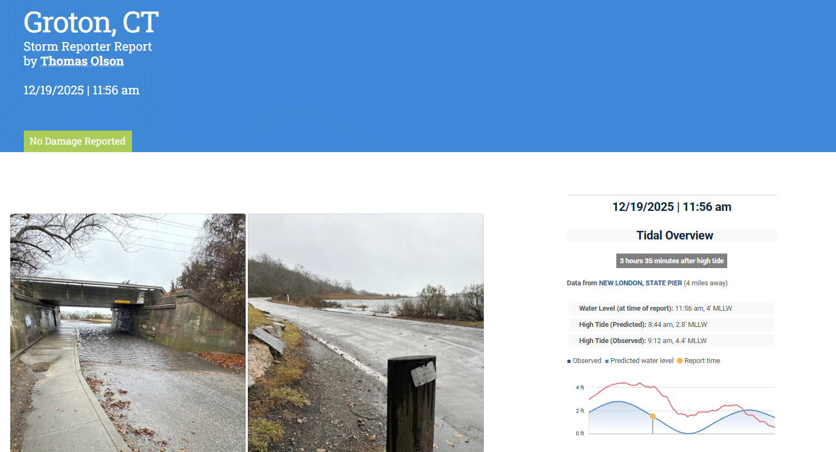

Slide 18
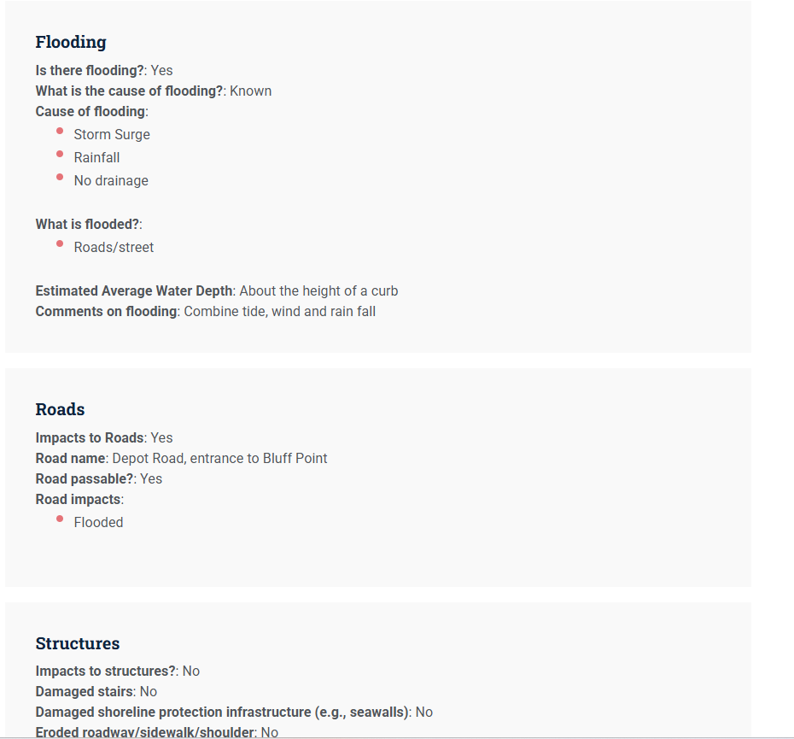

Slide 19
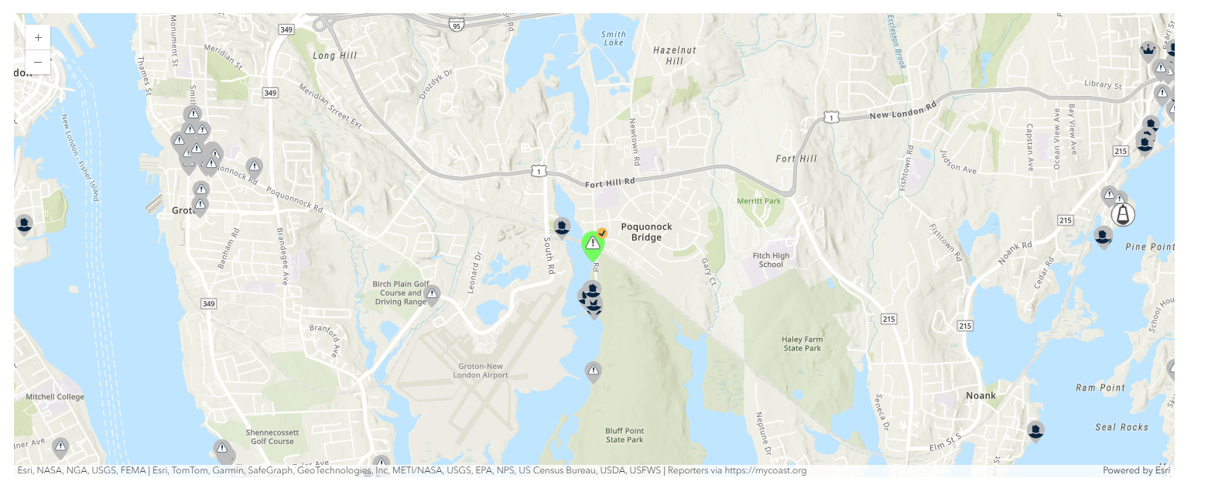

Slide 20
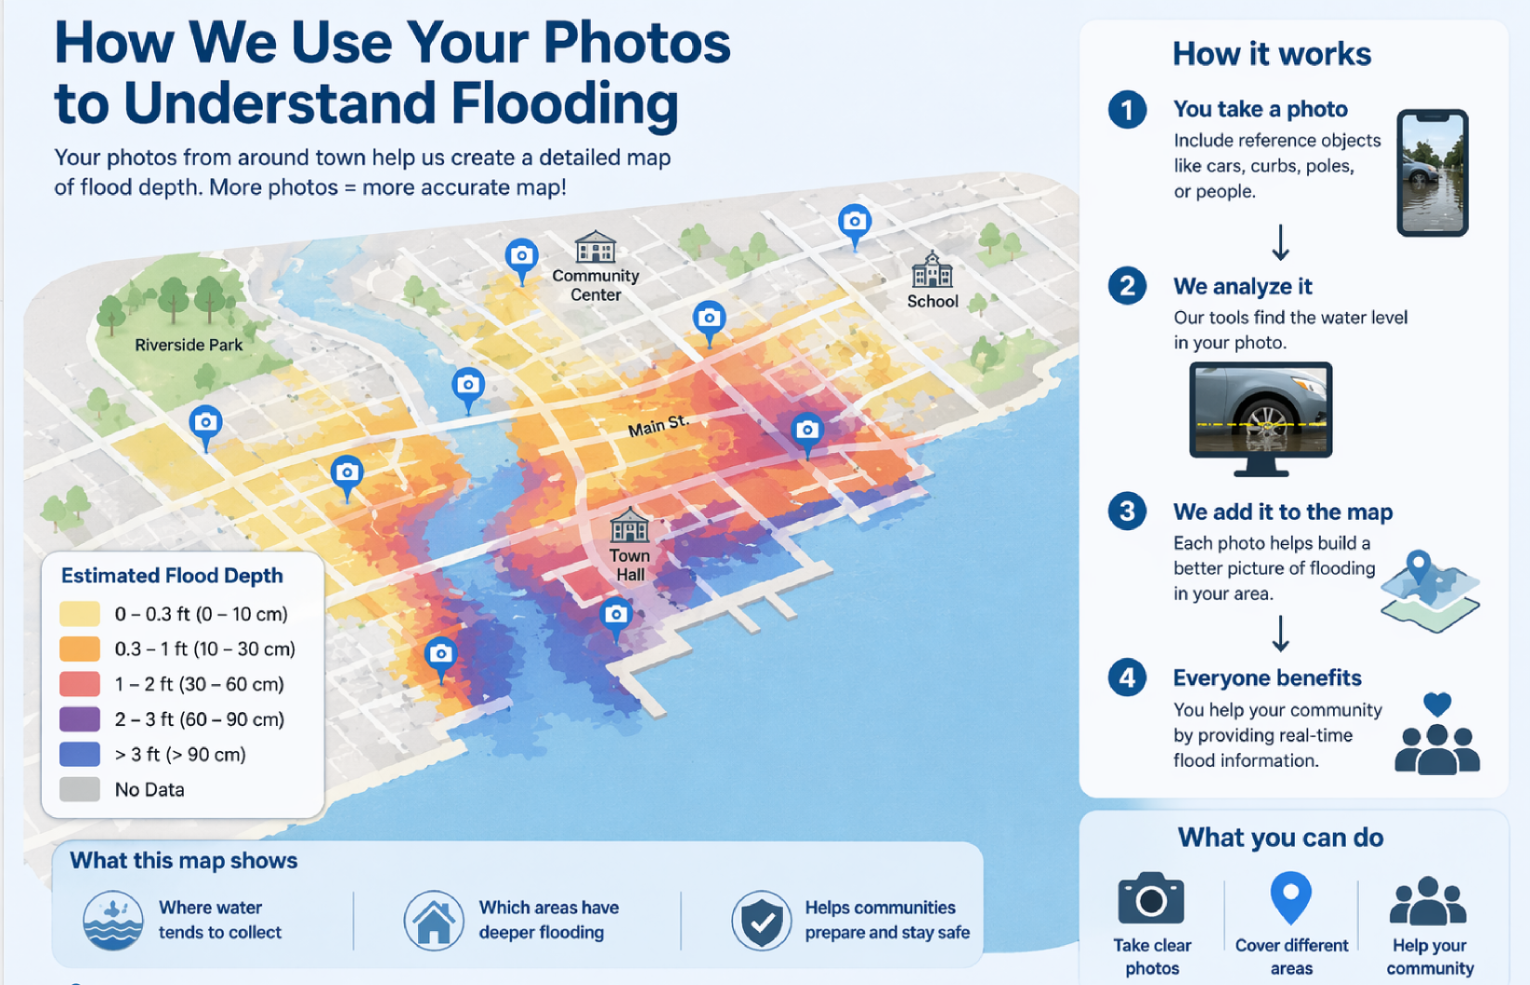


8
CAPTION

Slide 21
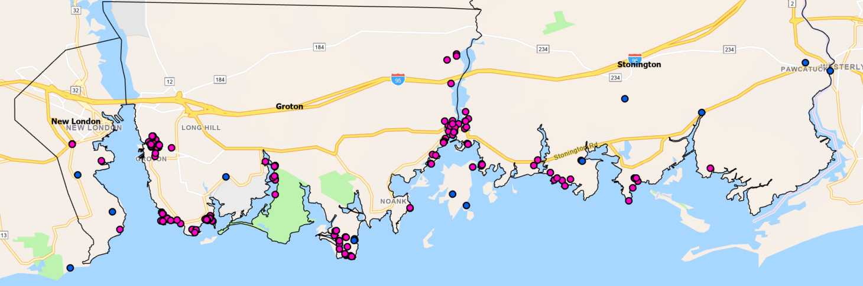
431 Submissions in CT
198 Submissions in Pilot Area
185 Submissions in 0.25 miles of identified point of interest
Only 5 were able to be used in CIRCA’s photo analysis

Slide 22
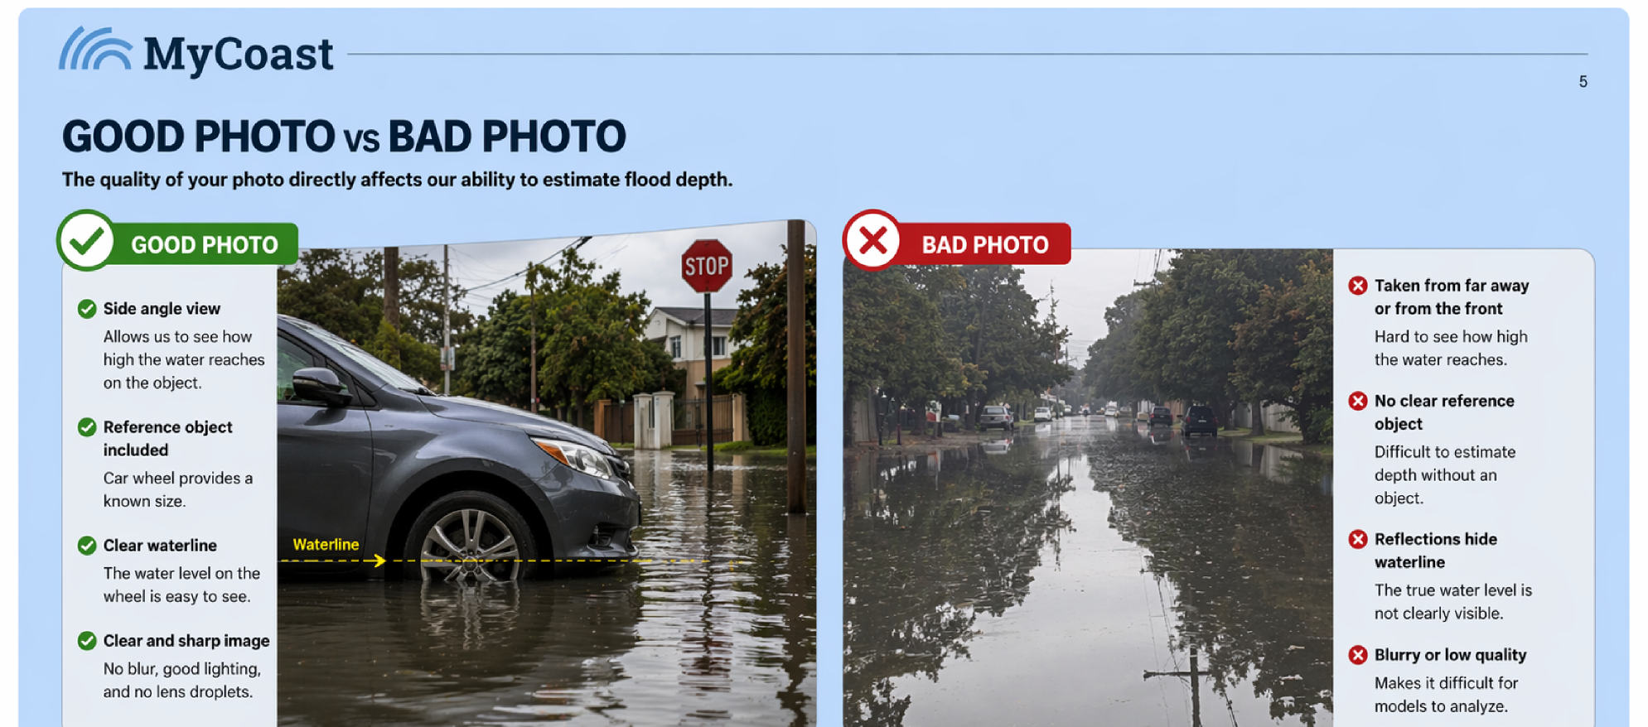

4

Slide 23
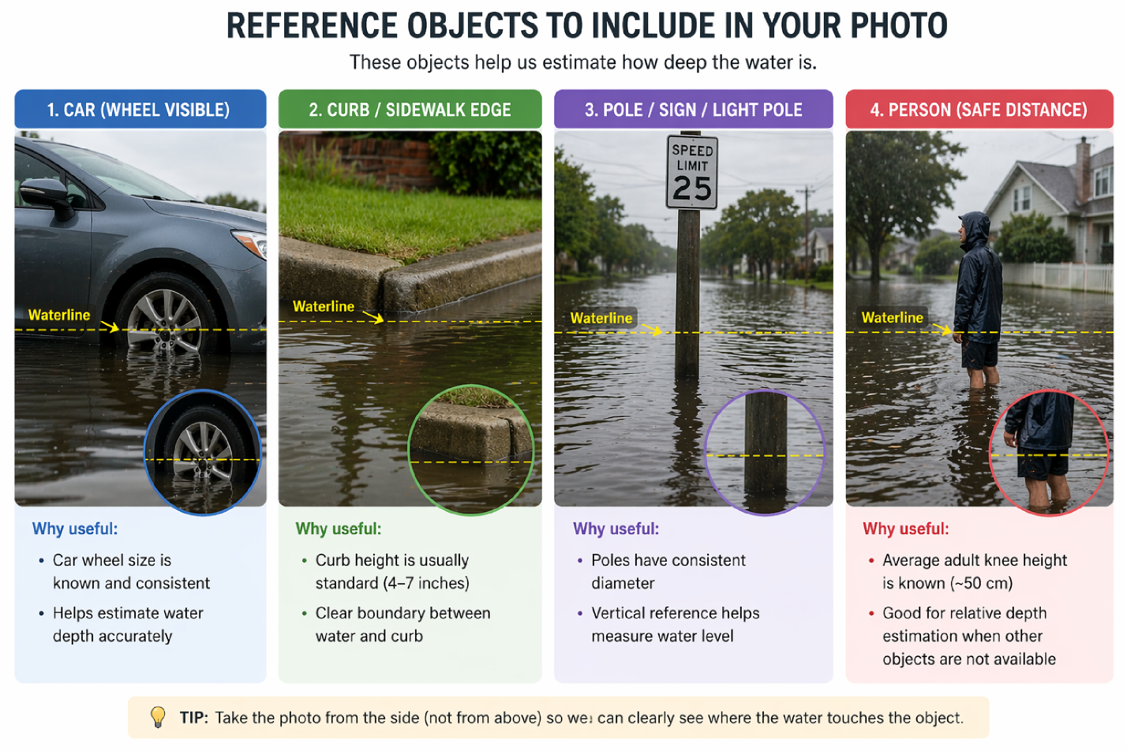

3

Slide 24
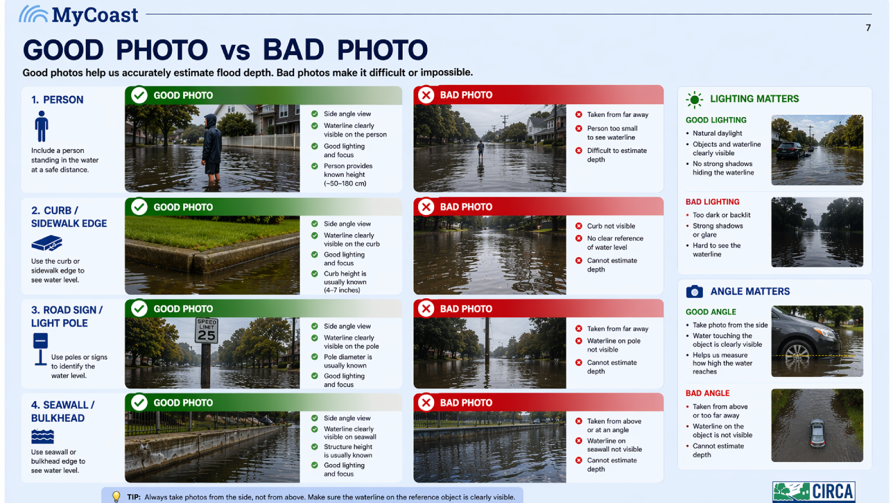

5

Slide 25
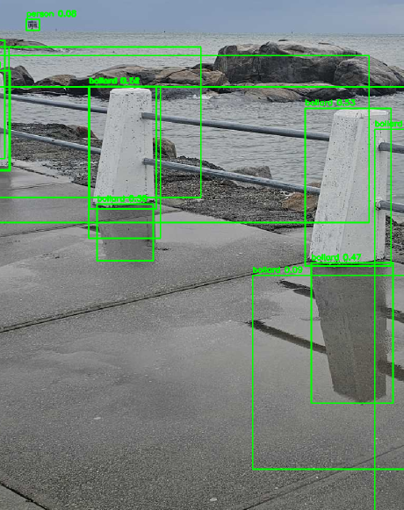
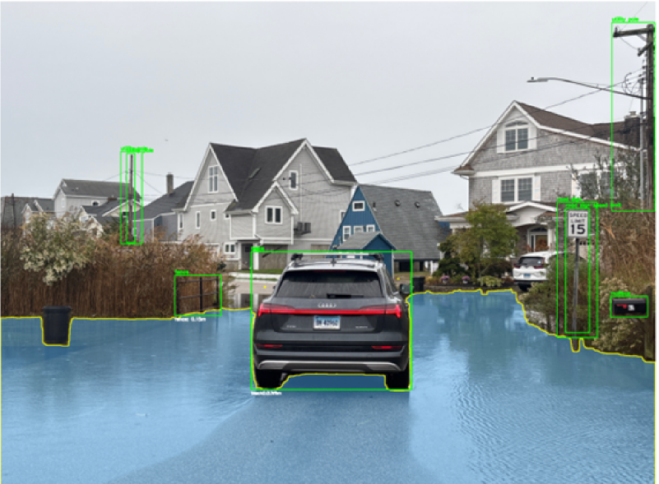
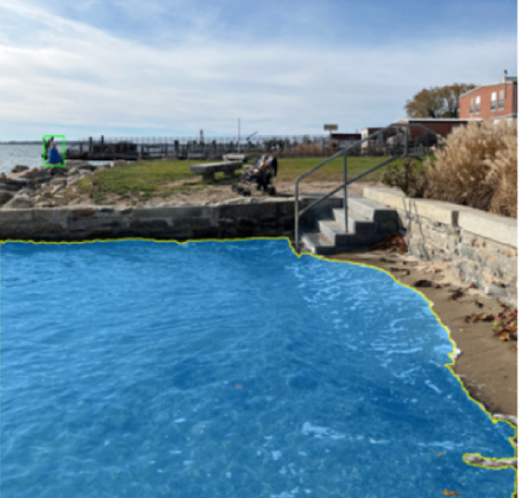
6
Photo-Based Flood Analysis Framework

Slide 26
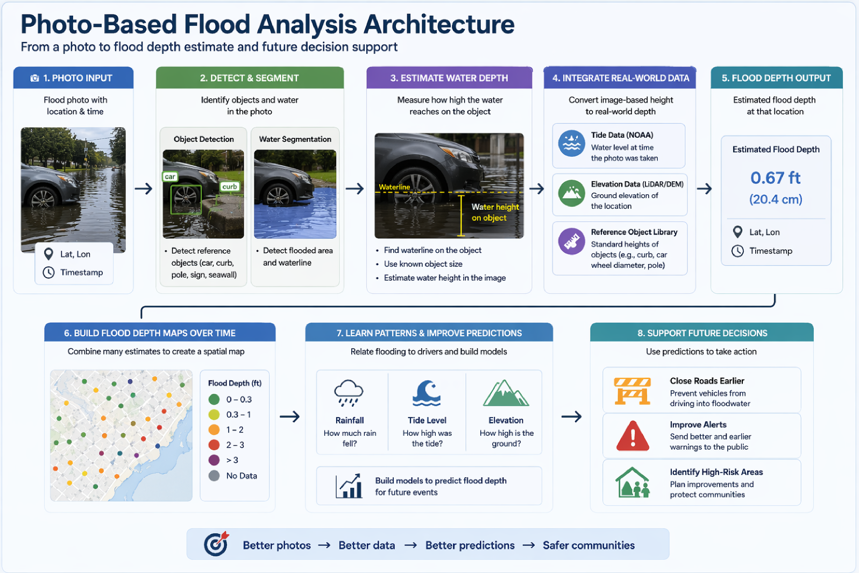
7
CAPTION

Slide 27
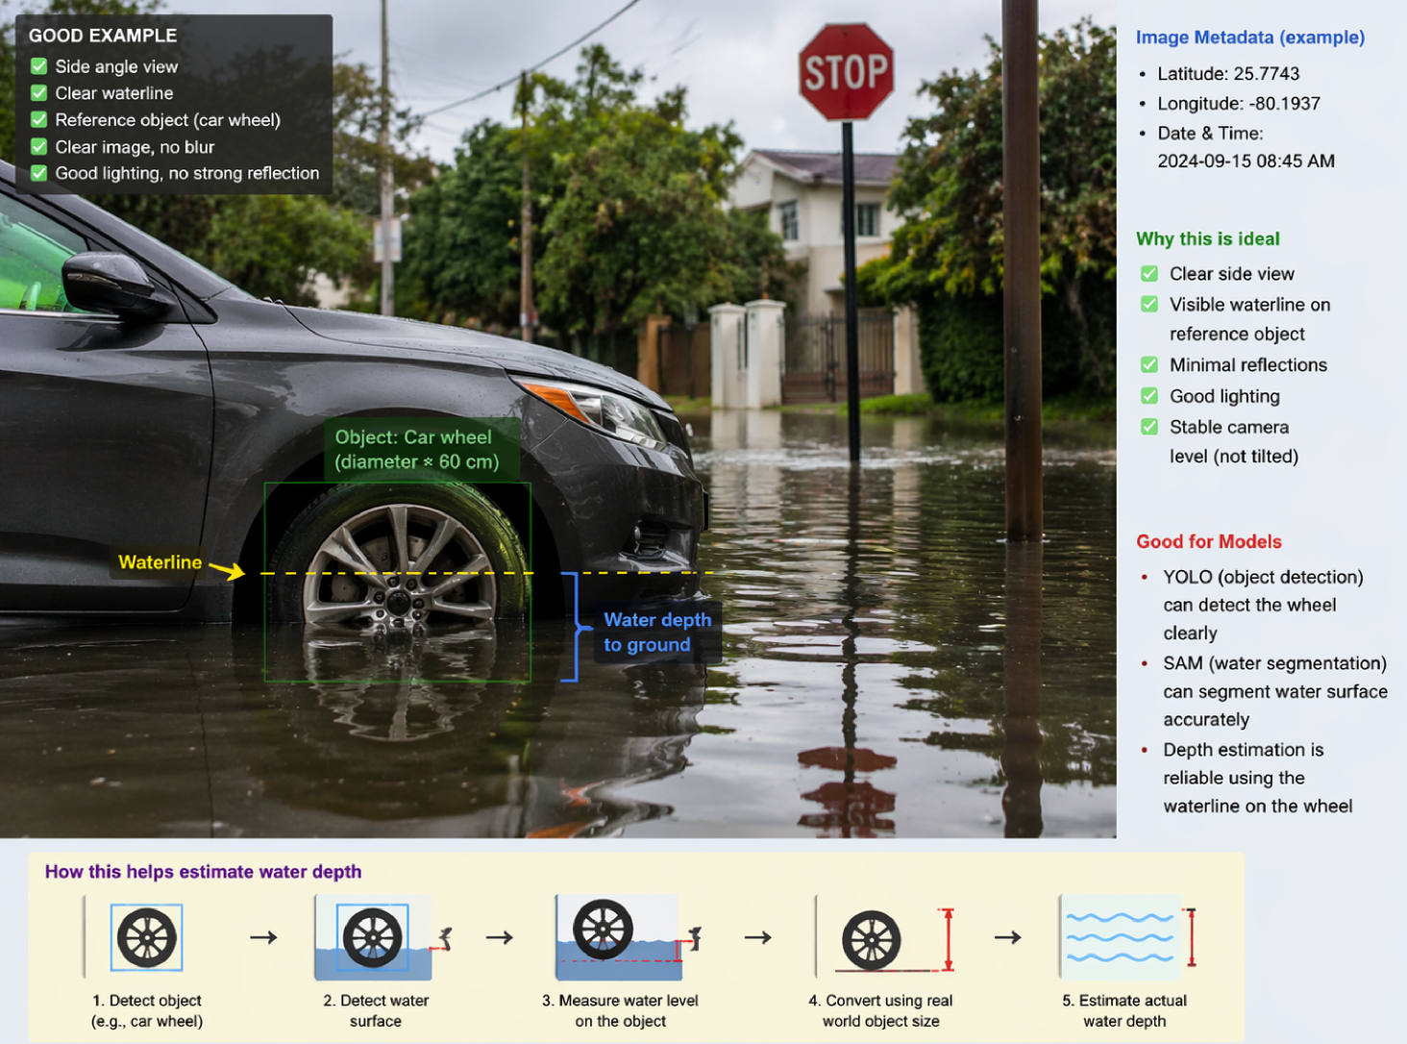
9

Slide 28


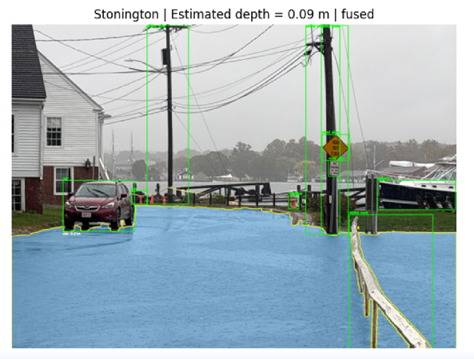

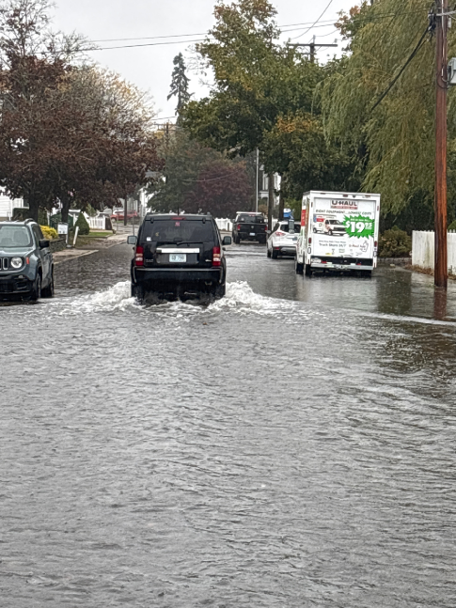
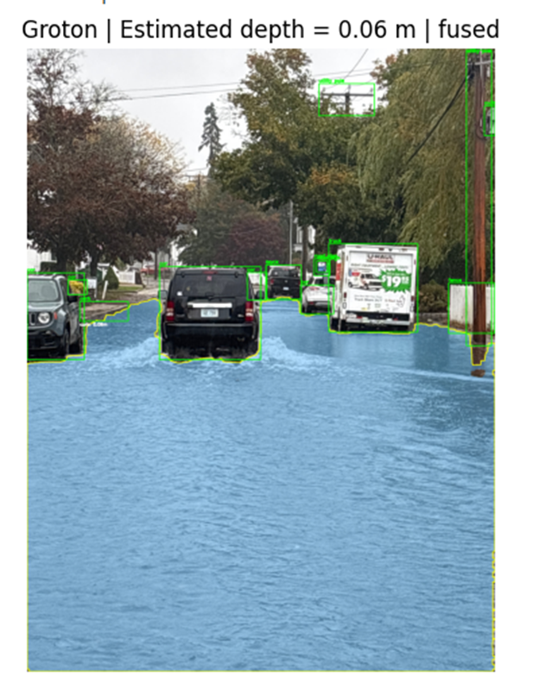

Example Results

Slide 29
BREAK for PETER’s slides

Slide 30
Katie introduces additional local speakers

Slide 31


Slide 32


Slide 33

Pearl Street in Mystic
Photo Credit: K. Lund
Example MyCoast Report 2

Slide 34


Groton Long Point Police Station
Photo Credit: M. White
Example MyCoast Report 1

Slide 35

Groton Long Point – DEEP Climate Resilience Fund Application

Slide 36


Slide 37
Next Steps
Planning for the Future of MyCoast Connecticut

Slide 38

432 MyCoast Connecticut Reports since 2011 across 25 municipalities
Notes:
Top contributors include Groton with 144 reports and Branford with 131 reports
This is where we’re starting as of April 2026 and we are hoping to build on this number over the next year as we continue with our current

Slide 39

Our Goals
Offer the MyCoast Connecticut Program STATEWIDE!
We already have support from 4 COGS and 7 communities!
Form an Advisory Committee comprised of municipal leaders, community champions, COG representatives, and state officials.
Notes:
Some of which hare on this call – thank you so much for your support

Slide 40
Our Goals
Further develop MyCoast Connecticut to best align with community and state needs.
Work with Branford to merge programs
Incorporate additional coastal and inland community perspectives
Explore avenues for stable funding source
Offer MyCoast Connecticut engagement and outreach materials statewide
Notes:
Fill out our MyCoast Interest Form: MyCoast Connecticut Interest Form – Fill out form

Slide 41
Grant Development
Applying to Long Island Sound Futures Fund
Due May 19, 2026
Gathering Letters of Support
Please let us know if you’re interested and willing to contribute
Email me: sarah.schechter@uconn.edu
Meeting 50% cost-share requirement
Notes:
Thank you to everyone who has already provided letters of support and committed match
Add my contact info in the chat
Add interest form to the chat

Slide 42


